Slide 1
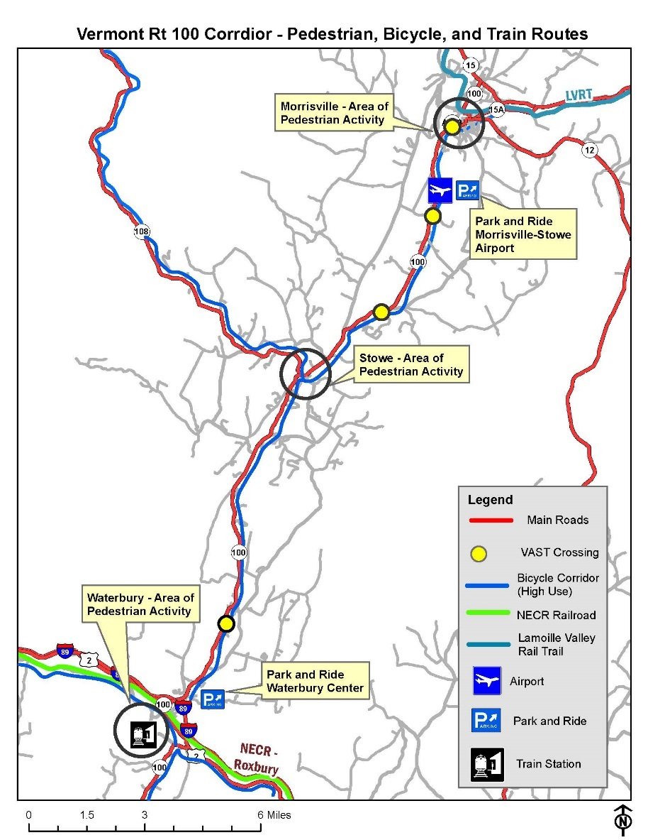
VT 100 and VT 108 Corridor Management Planning
August 24, 2017
Corridor Stakeholders Meeting

Slide 2
Agenda
10:00 - 10:10: Welcome and Introductions
10:10 - 10:40: Presentation
Corridor Management Overview
VT 100-108 Corridor Transportation Assessment
10:40 -11:30: Breakout Sessions
11:30 -11:50: Report Out
10:50 -12:00: Wrap-up & Next Steps

Slide 3
Corridor Management Objectives
Incorporate local needs in a focused and effective way
Coordinate & Leverage Investments
Identify practical, short term projects.
Identify longer term needs.
Integrate into maintenance, projects and permitting.
Make Asset Management the foundation
Engage VTrans staff so we “own” the plan
Access Manag.
Land Use & Zoning
Economic Dev.
Natural Resources
Roadway Ops
Roadway Capacity
Ped & Bicycle
Public Transit
Airport Access
Rail
Asset
Management

Slide 4
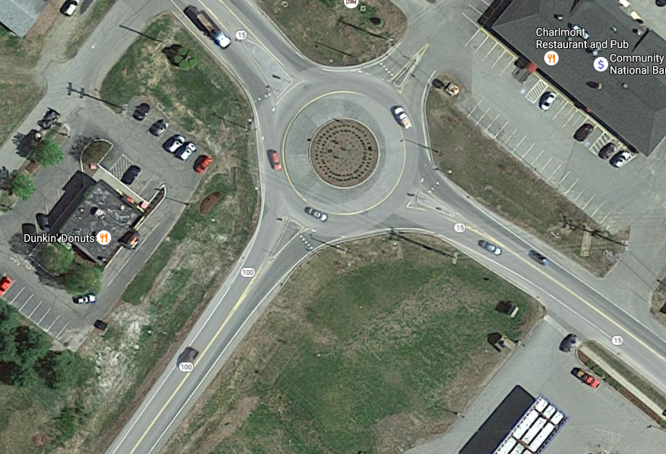
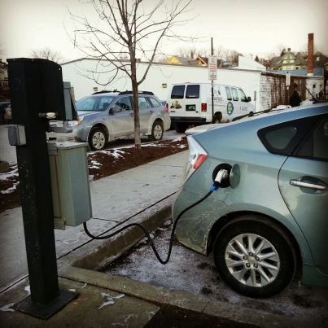
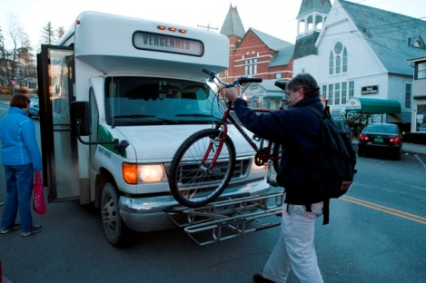
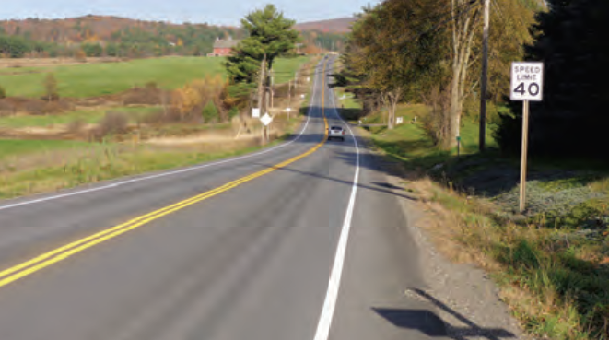
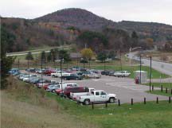
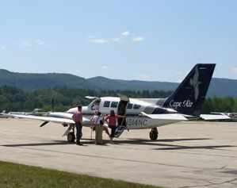
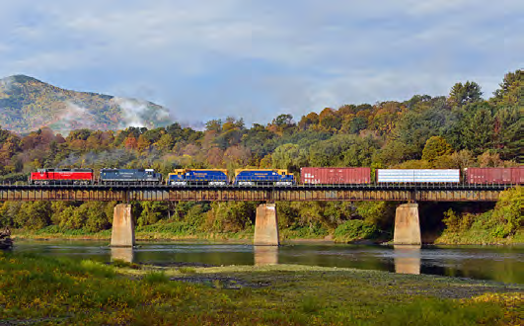
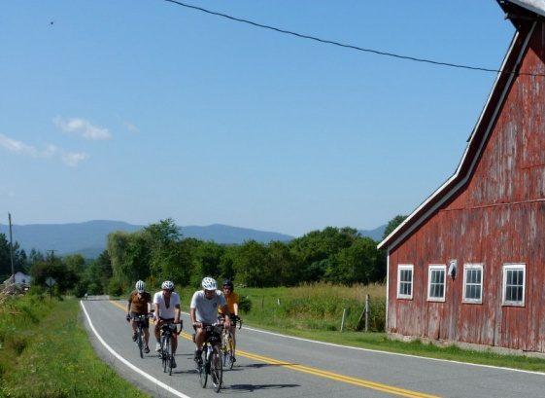
What are we trying to achieve?
A safe, efficient and multimodal transportation system that promotes Vermont’s quality of life and economic wellbeing

Slide 5
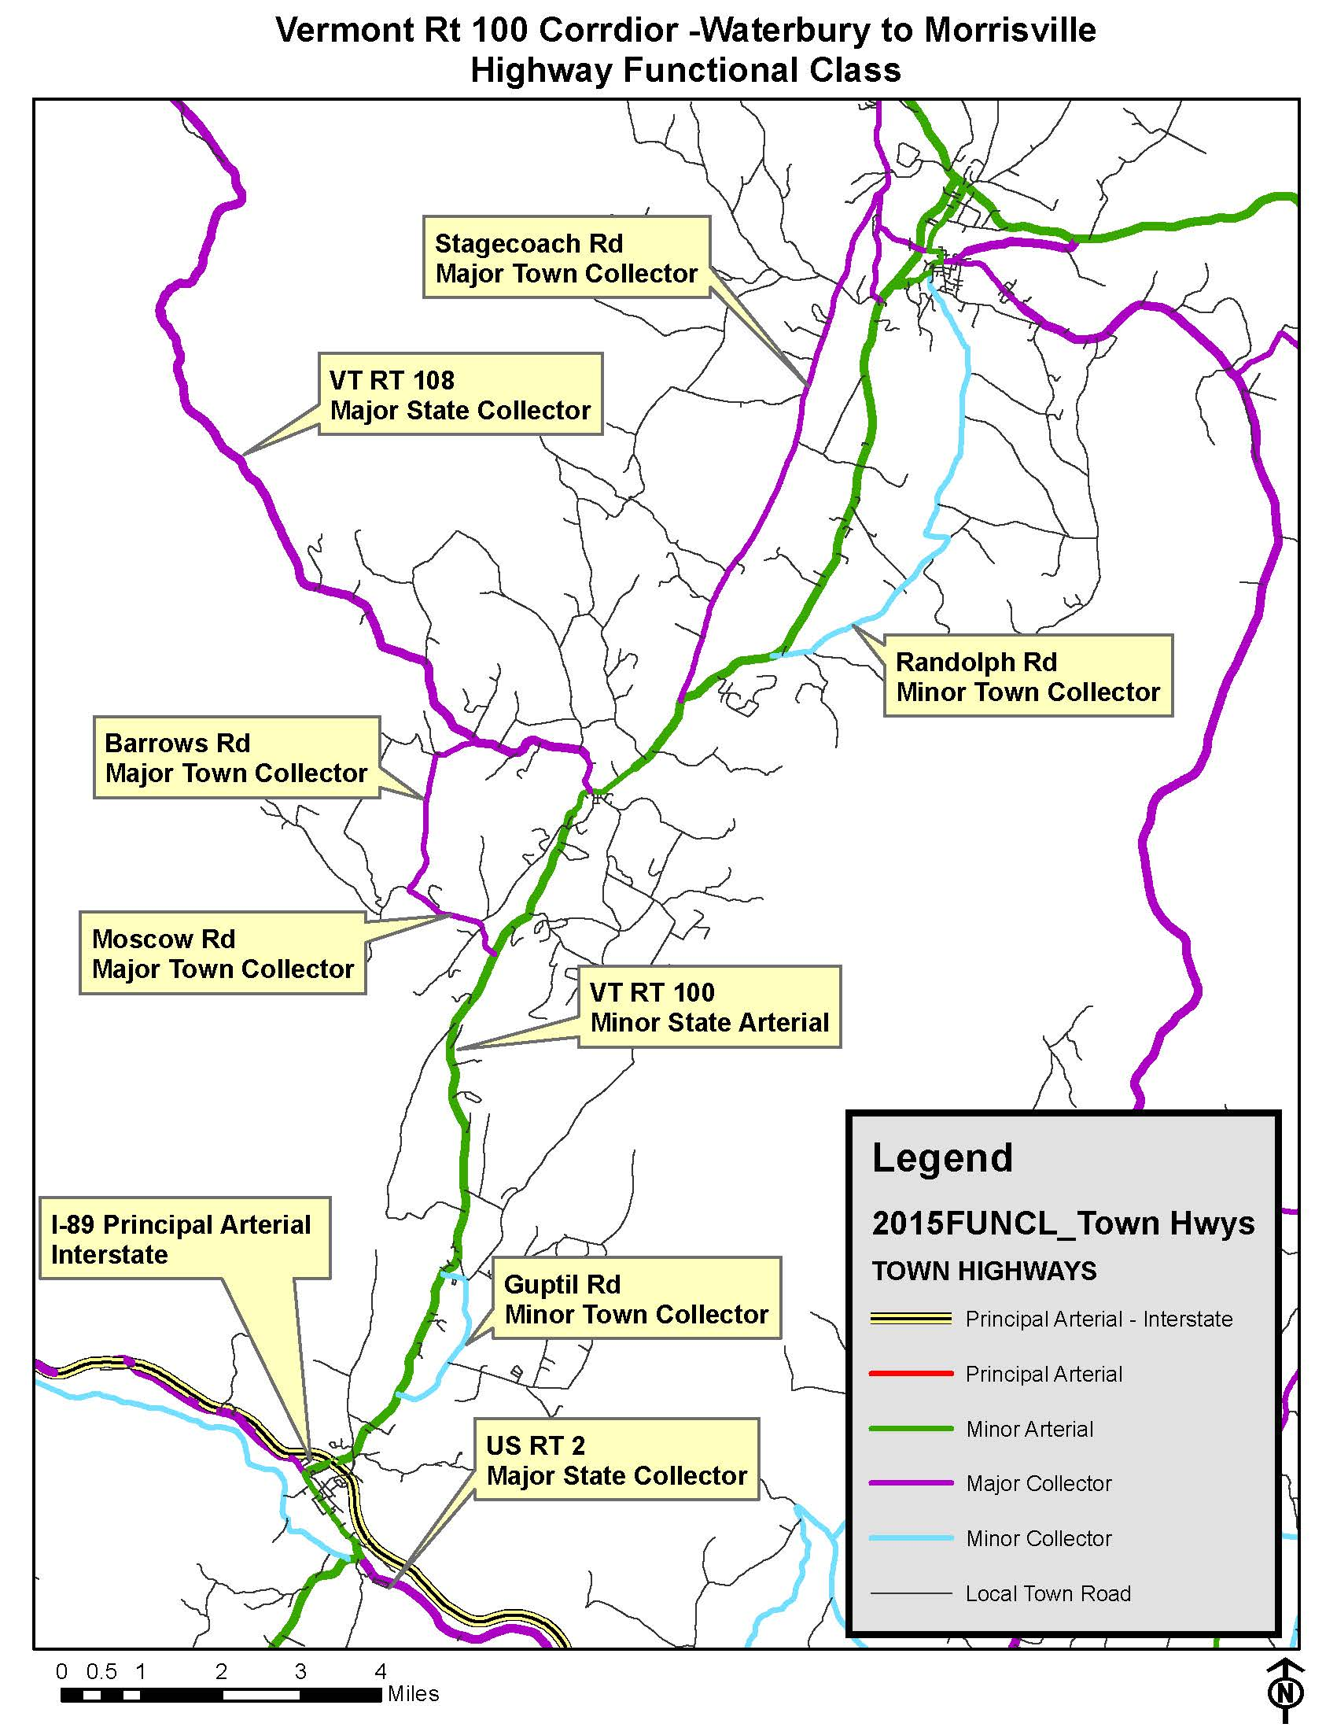
General Characteristics
Population: 14,517 (2010 Census – 3 municipalities)
Employment: 11,704
Primary 2 lane roads,
11-12ft lanes and varying shoulder width
Built up centers in Colbyville, Waterbury Center, Stowe, and Morrisville connected by rural two lane roadways.
Major Tourist Destination

Slide 6
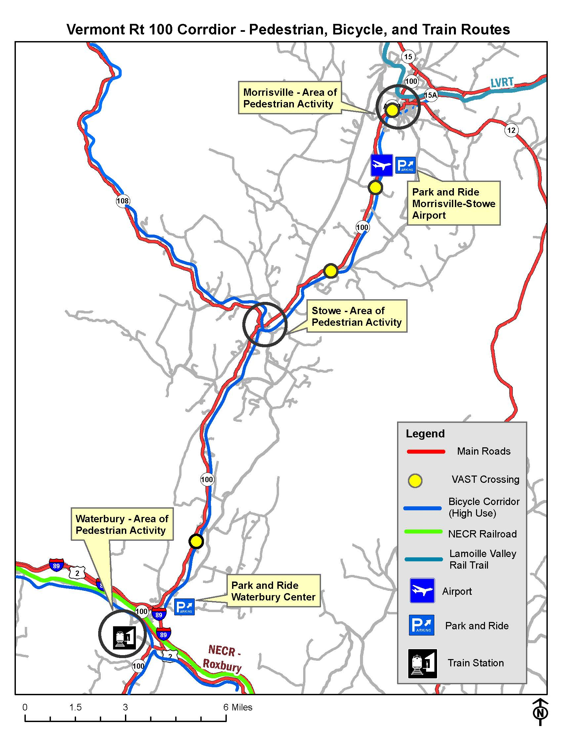
Mul
General Characteristics
State Airport in Morrisville
High VTrans Bicycle Corridor.
Stowe Recreational Bike Path.
Lamoille Valley Rail Trail
Areas of Pedestrian Activity – however no sidewalks in Colbyville and Waterbury Center
Train Stations – NECR in Waterbury Village with Amtrak service from Washington DC to St. Albans
Park and Ride Facilities

Slide 7
General Characteristics
Transit fixed route service from Morrisville to Waterbury with connections to Montpelier, Burlington, and the Mad River Valley:
Montpelier LINK Express
Mountain Rd. Shuttle
Waterbury Commuter
Route 100 Commuter
Morrisville Loop
Morrisville Shopping Shuttle
SnowCap Commuter

Slide 8
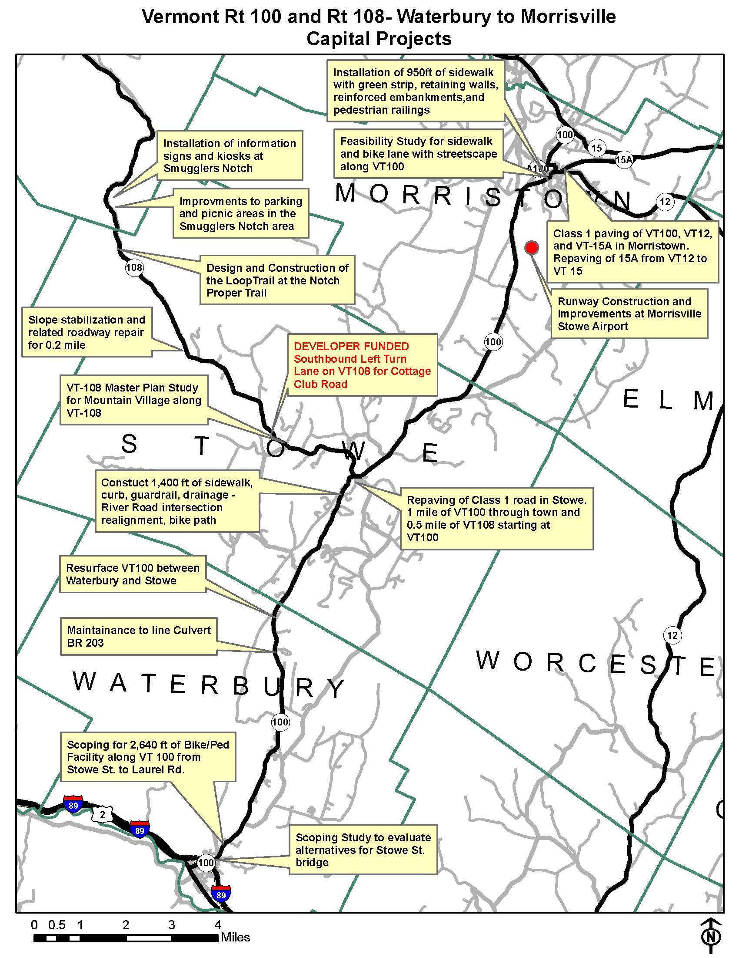
Current Projects
Current and future Capital projects along the corridor

Slide 9
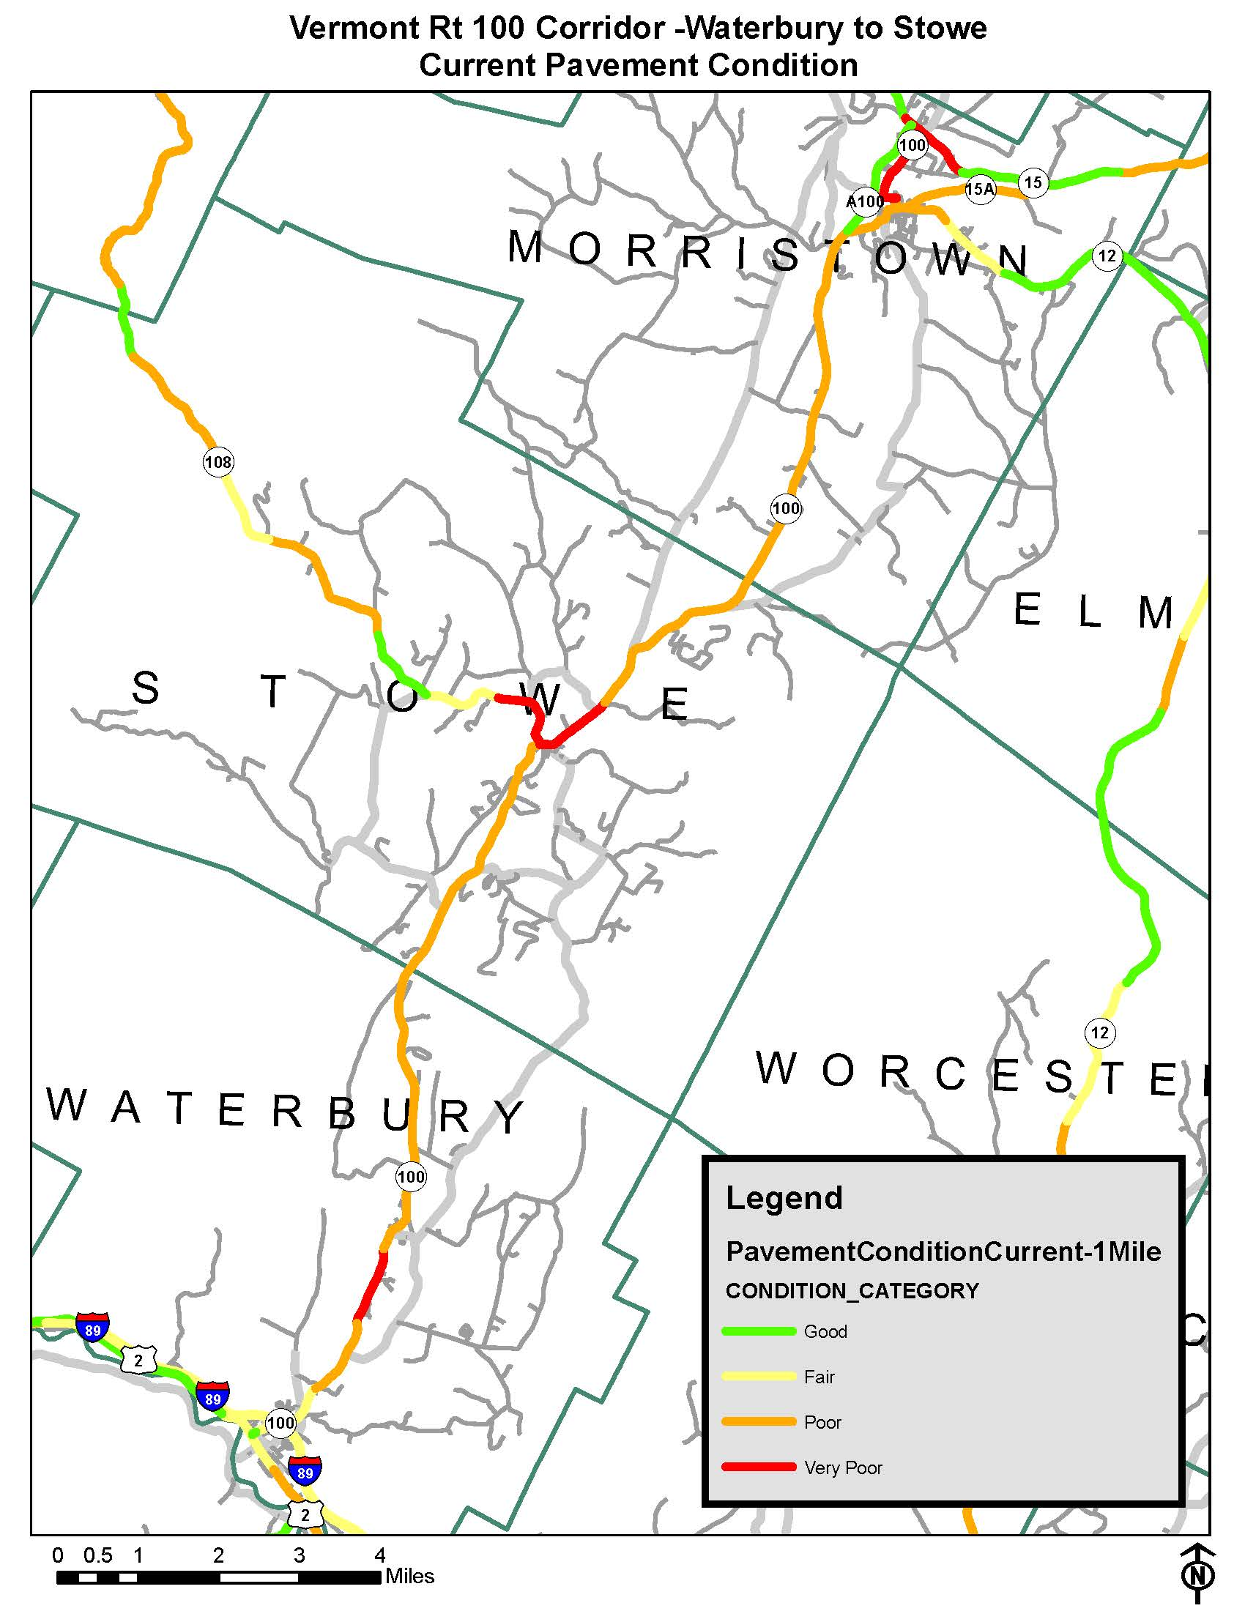
Pavement
2016 Pavement Conditions

Slide 10
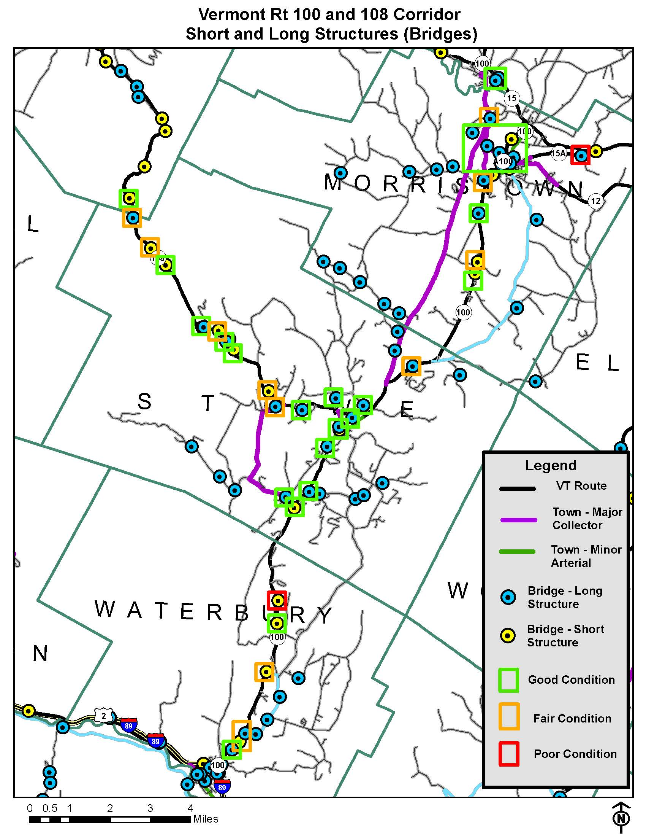
Bridges & Culverts
One bridge in VT 100 / VT108 Corridor listed as structurally deficient
20 Bridges in “Fair "Condition
25 Culverts in poor or critical condition

Slide 11
VTrans Identified Corridor Asset Needs
Example: 10 Roadside drainage issues – Waterbury/Stowe portion of corridor

Slide 12
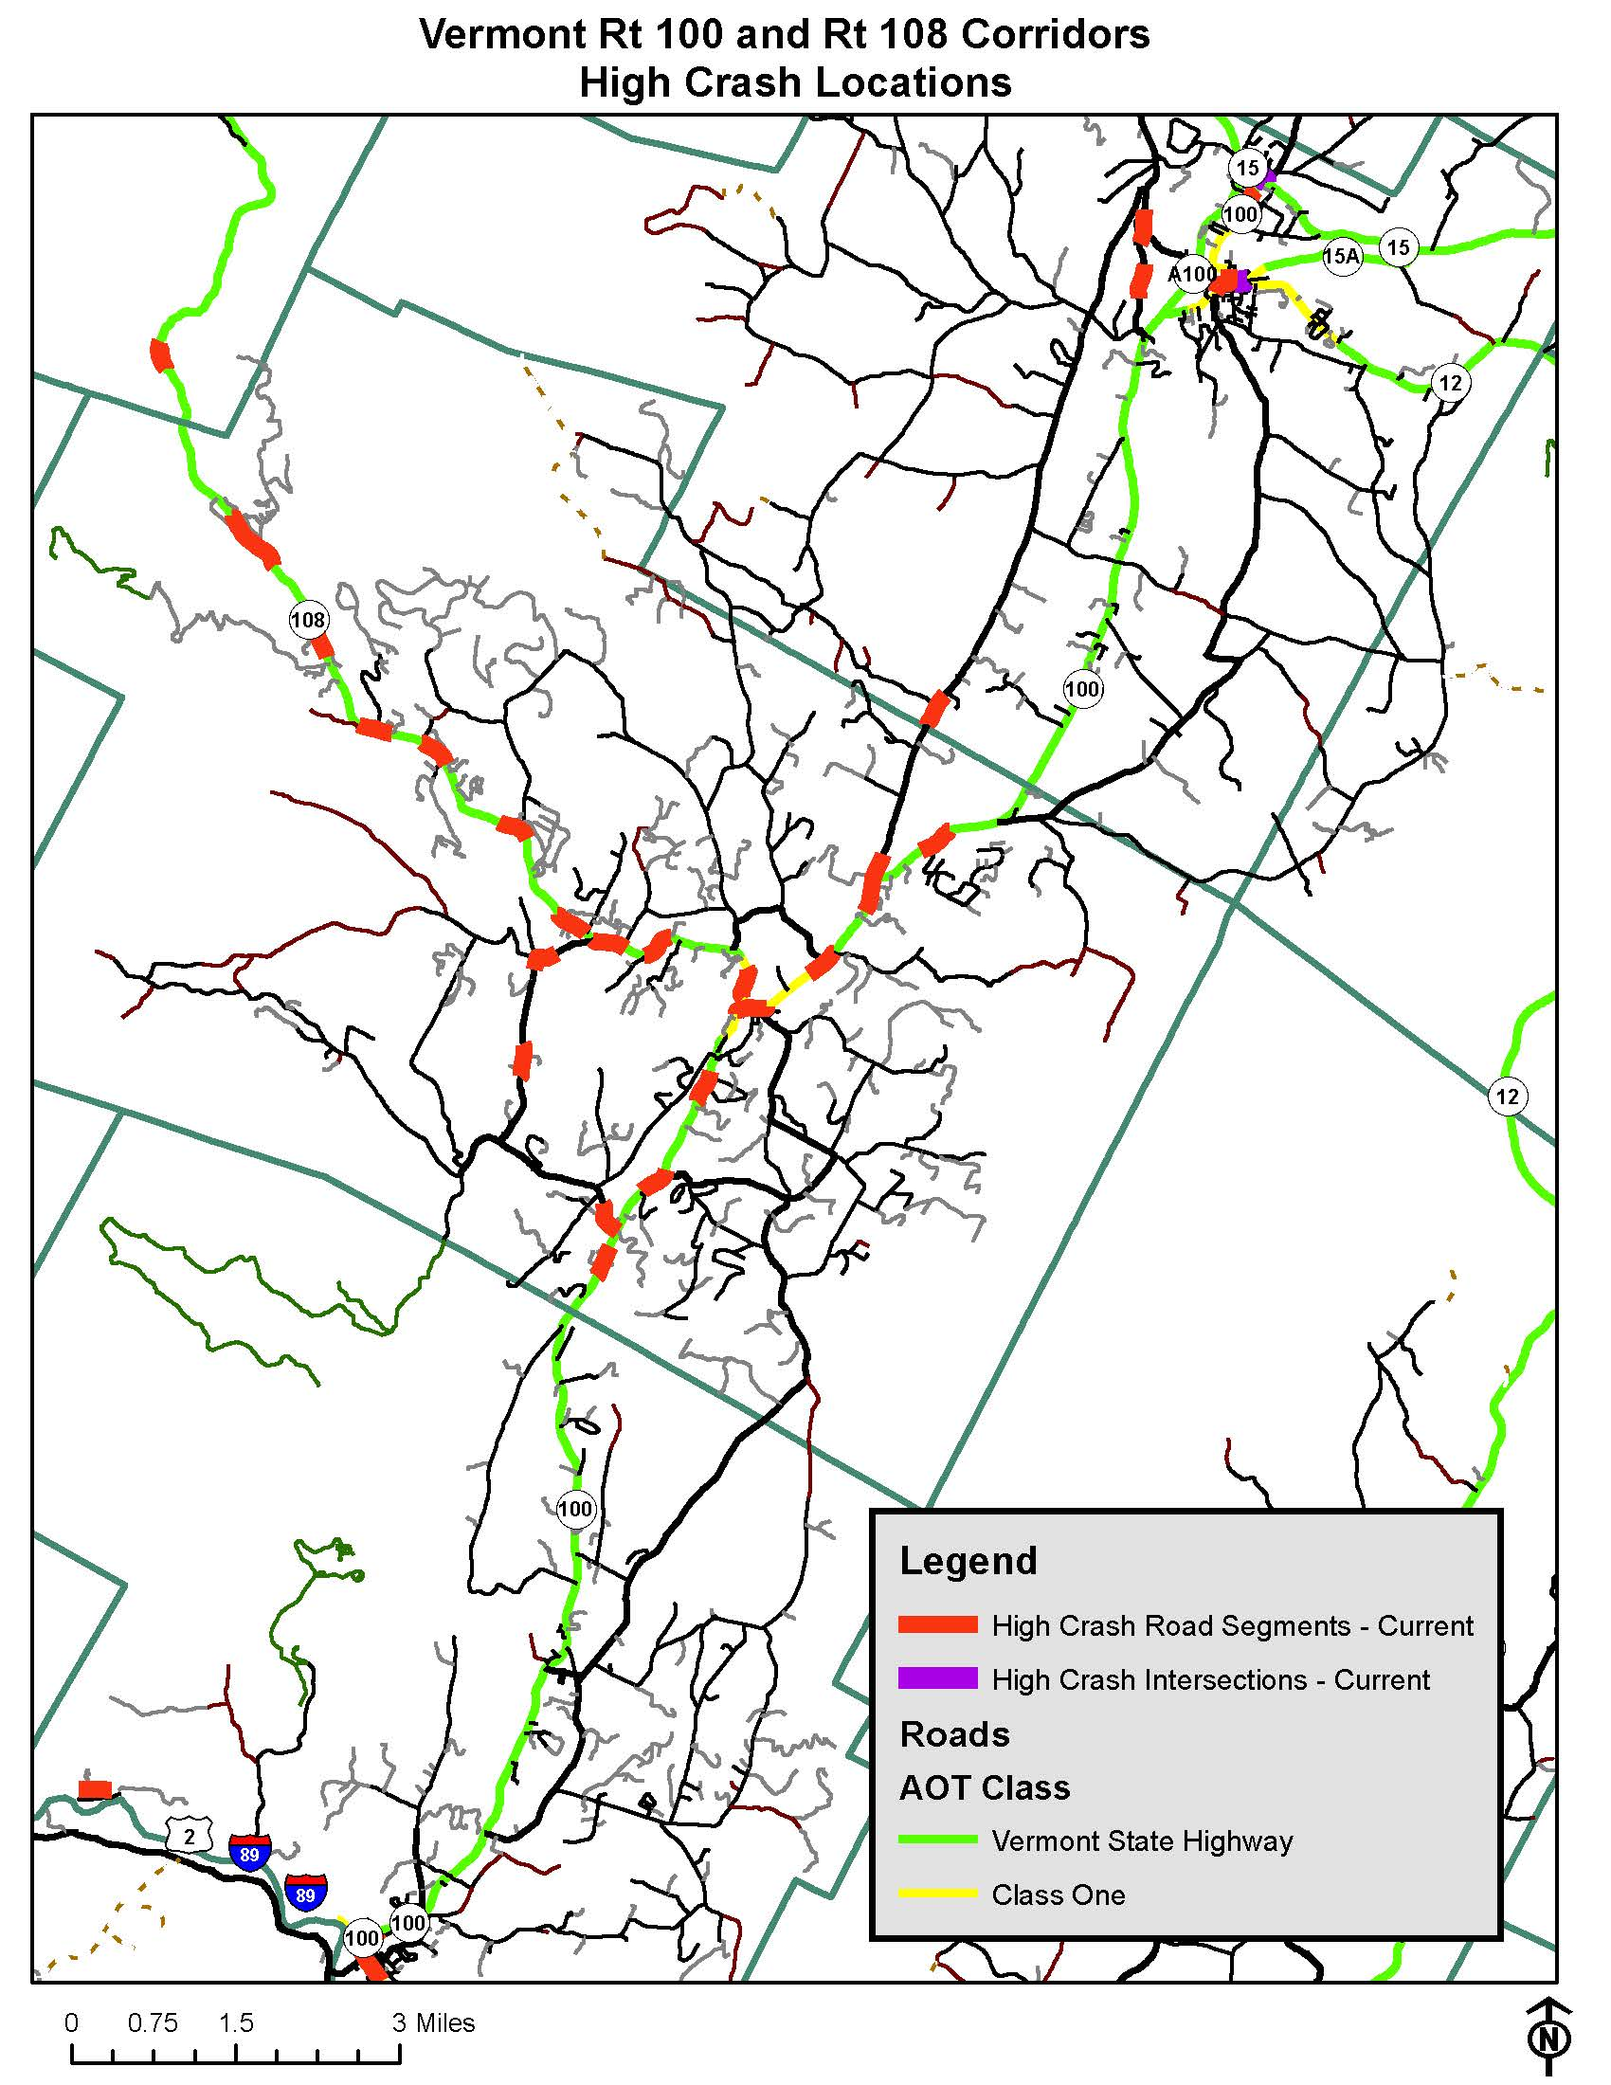
Safety
VT 100 and VT 108 High Crash Locations

Slide 13
VT 100 and VT 108 Crash Summary
Almost all of the high crash locations occurred in the towns/villages and along various segments of VT 108.
The corridors from Waterbury to Stowe and Stowe to Morristown had minimal crashes.
Most crashes were vehicular damage only.
Most town/village crashes were “driver behavior” related: inattention, following too closely, parked cars not looking etc.
They were low speed accidents.
Most crashes along VT 108 are rear ends due to driver inattention to left turns.
Historical High Crash data not an effective measure of Morristown portion of the corridor due to the construction of the Alternate Truck Route (ATR).

Slide 14
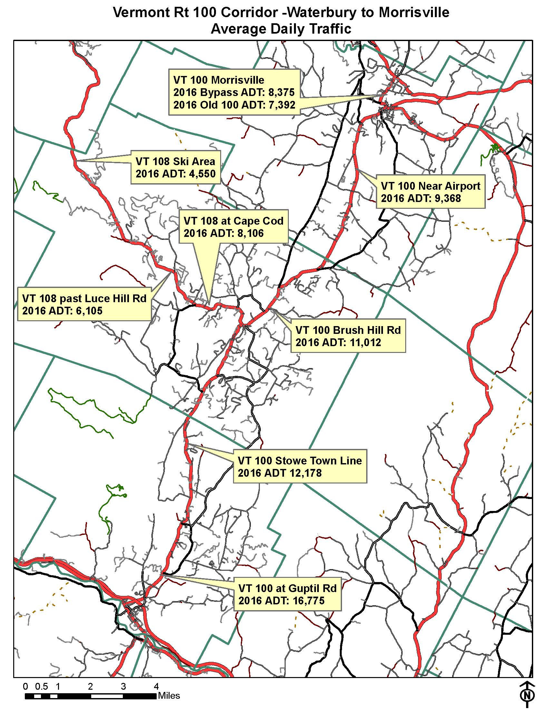
Traffic Volumes
Corridor traffic is growing (last 6 years)
22% increase near Guptil Rd
5% increase along Stowe Main St.
No change along VT-108 near Luce Hill Rd. 23% increase along VT-108 at the mountain
17% increase near the airport
50% Decrease on Old 100 in Morrisville
Relatively low tractor trailer volumes – less than 2% of traffic volumes

Slide 15
2015 -2016 Average Monthly Traffic

Slide 16
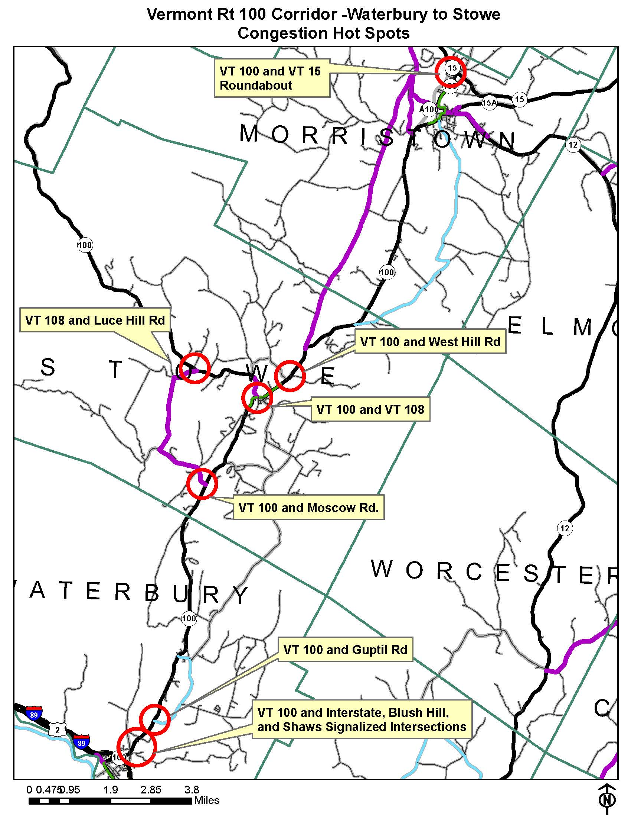
Traffic Congestion Hot Spots
Seasonal and Special Event Variations:
Lacrosse Tournament
Stowe Car Show
Winter Skiing:
Christmas
New Years
Martin Luther King Day

Slide 17
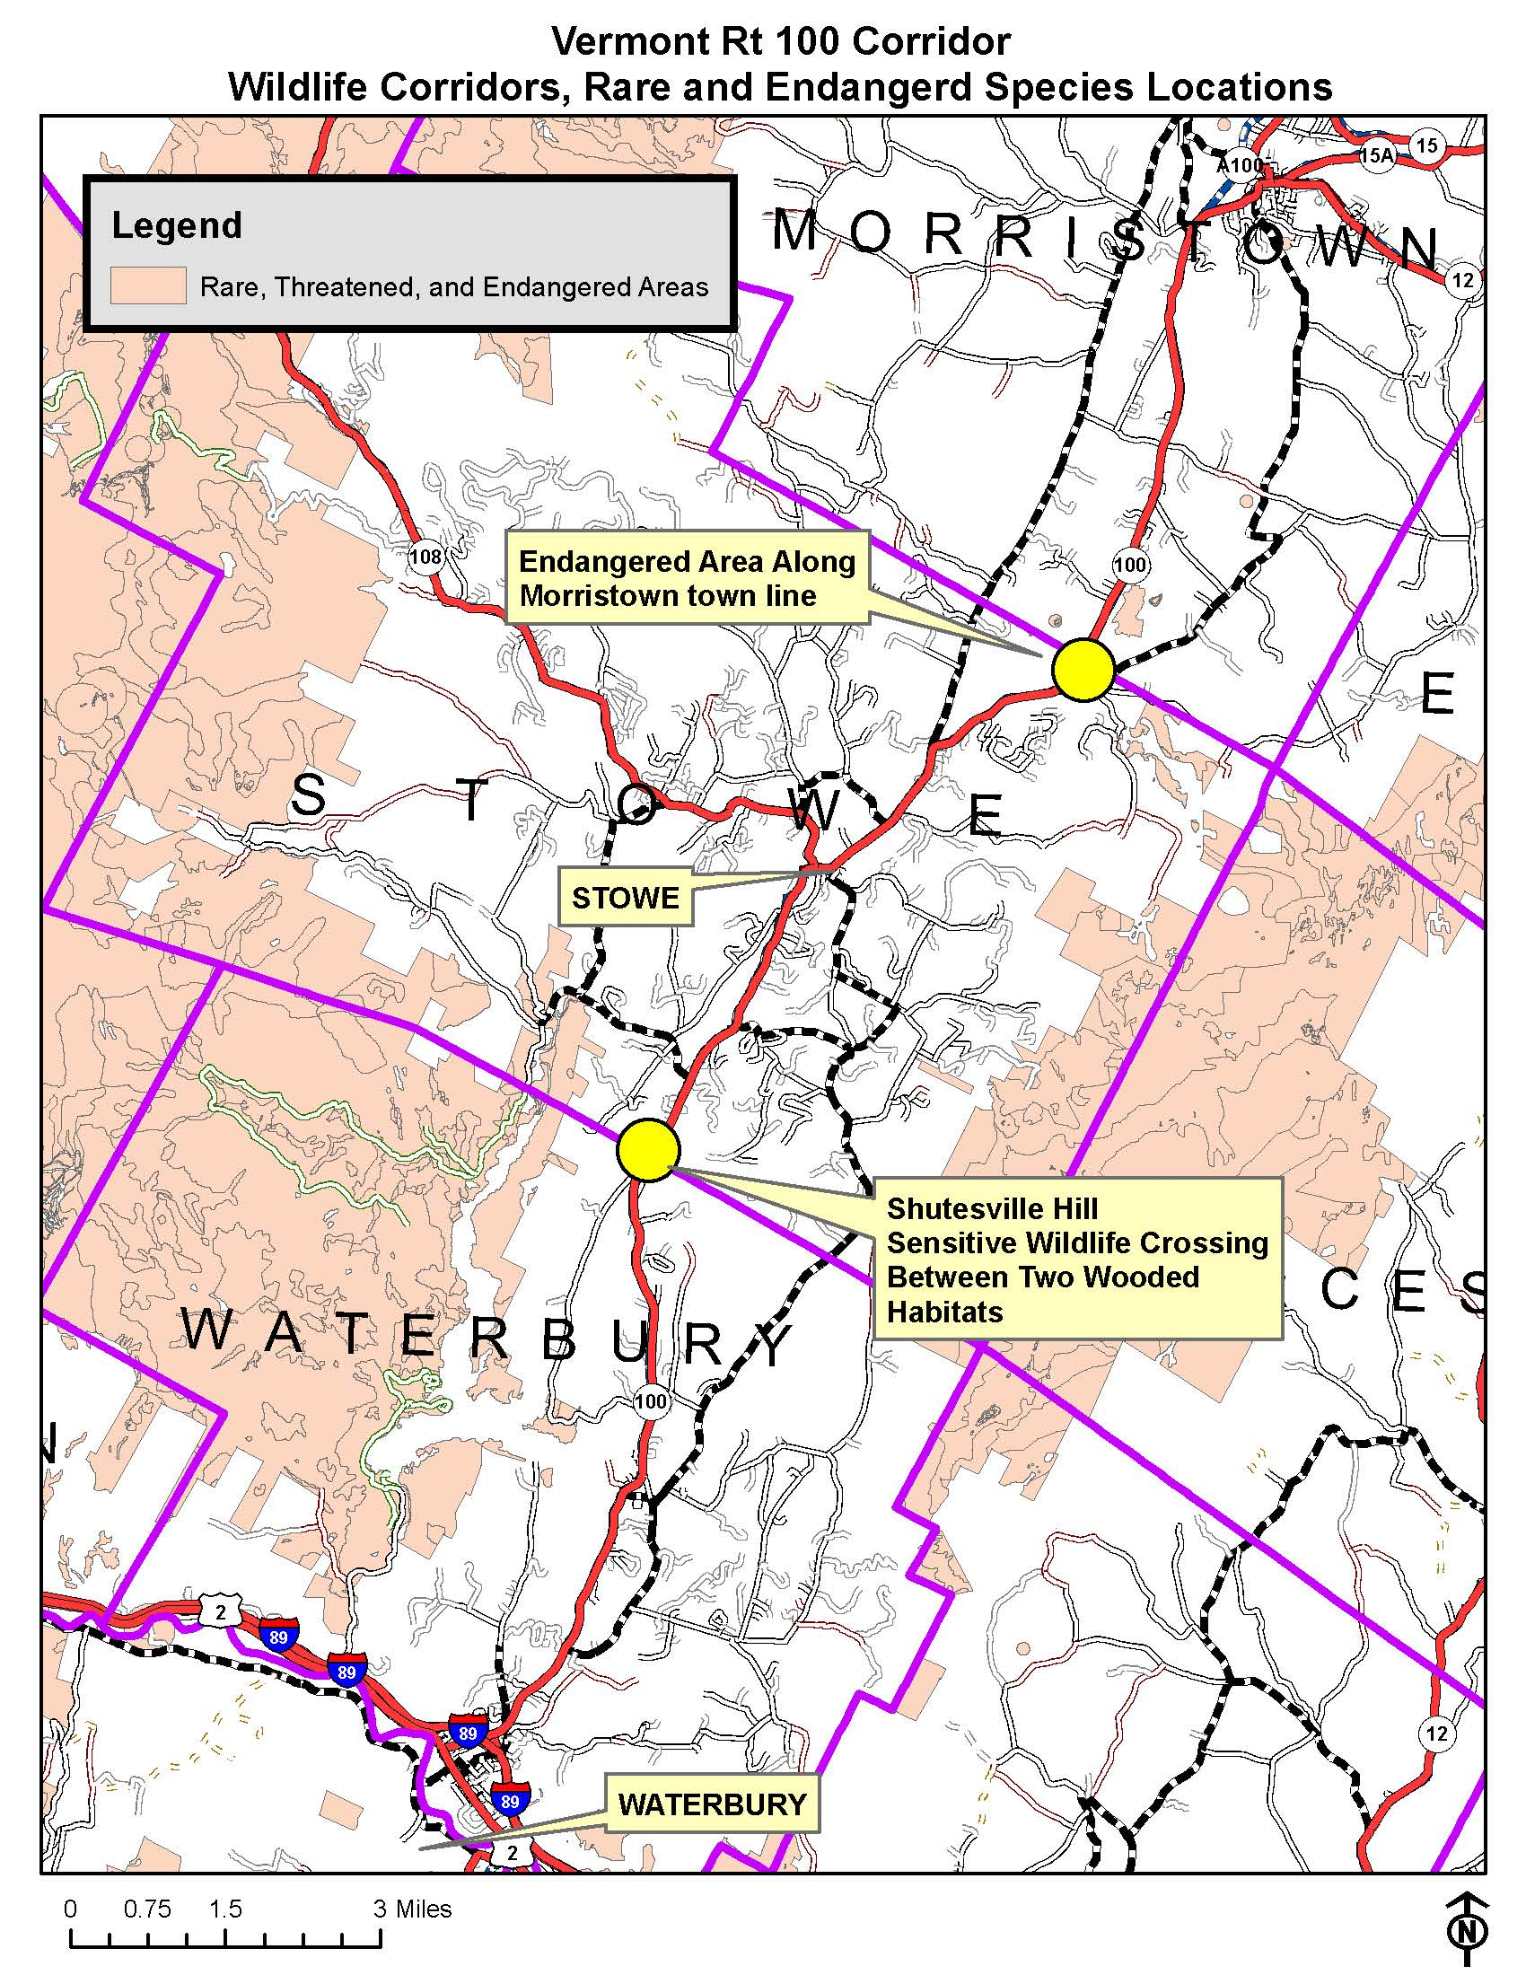
WilWil
Wildlife Corridors and Endangered Species Locations

Slide 18
Local Needs and Activities
VT 108-Luce Hill Improvements
Roundabout at VT 100-Moscow Rd
Traffic Signal and VT100 – Guptil Rd
Traffic Signal at VT100 – West Hill Rd
Pedestrian Crossing with Pedestrian Signal Heads for VT-15 & VT-100 intersection in Morrisville
Alleviation to Traffic Congestion along VT-100 near I-89 in Waterbury
Widen Shoulders Along the Byway Where Appropriate to Accommodate Bicycle Traffic – (Green Mountain Byway Corridor Management Plan)
Evaluate Current Transit Systems and Identify Missing Links (Green Mountain Byway Corridor Management Plan)

Slide 19
Breakout Session Questions
What information is missing?
What ideas do you have to improve transportation in the corridor?
Short-term, quick fixes
Future Needs (10 years)
How can we work together to implement ideas?
Is there anything else we should be considering?

Slide 20
Next Steps
Prepare Implementation Plan and Review with Stakeholders
Prepare on-line Document
Schedule Annual Corridor Management Plan Status Meeting
Implementation Plan Elements
Issue or Idea Description
Purpose and Need
Order of Magnitude Cost
Funding Options
Coordination Opportunity
Responsible Entity
Partners
Timeframe(Short/Long Term)
Next Steps

