Slide 1
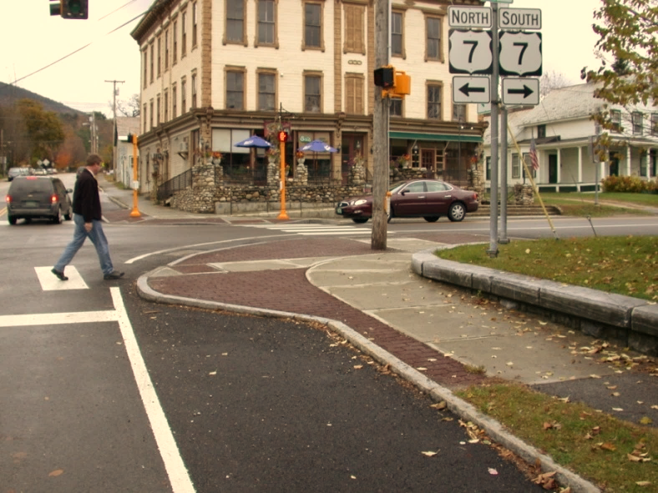

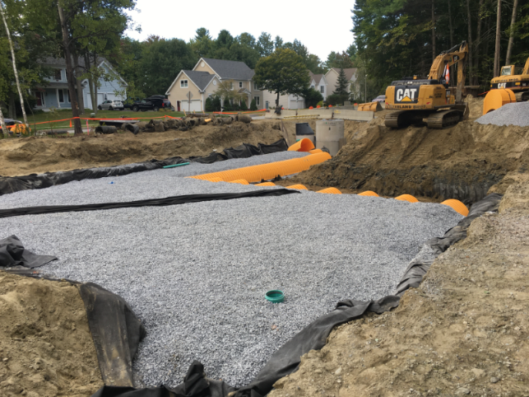
VTrans TA Program Fall 2023 (SFY 2024)
By
Scott Robertson, P.E. (scott.robertson@vermont.gov)
Notes:
Self Intro
Sign in sheet for credit to fill out application
MAB Local Projects website
Announcement Letter
Grant application guide
PowerPoint Presentation
Local projects guidebook / Appendix / ROW Guide / Bike/Ped manual
Ask questions at anytime – one at a time
Session will last about an hour. Will hang around for further questions
VIT Room – active for this session?

Slide 2
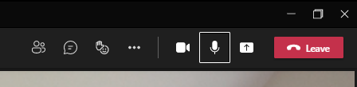
Microsoft Teams
use for this meeting
Chat
Raise Hand
Video on/off
Mute
Notes:
Self Intro
Sign in sheet for credit to fill out application
MAB Local Projects website
Announcement Letter
Grant application guide
PowerPoint Presentation
Local projects guidebook / Appendix / ROW Guide / Bike/Ped manual
Ask questions at anytime – one at a time
Session will last about an hour. Will hang around for further questions
VIT Room – active for this session?

Slide 3
Today’s Workshop will cover…..
Introduction
Federal Aid Essentials Website & VTrans Website
Eligible Applicants
Eligible Projects
Project Development Process Overview
Typical Project Costs Examaple
Project Selection Timeline
Project Development Timeline
Some Technical Points
Questions
Notes:
PDP – Local Projects Guidebook describes the PDP very well
In this session our intent is to raise awareness of the types of physical improvements that can improve walking / biking safety and accessibility, with some examples.

Slide 4
Transportation Alternatives (TA) Set-Aside from the Surface Transportation Block Grant Program (STBG) (23 U.S.C. 133(h)) under the Infrastructure Investment and Jobs Act (Pub. L. 117-58, also known as the “Bipartisan Infrastructure Law” (BIL)).
Approximately $4.3 million in federal dollars to be awarded.
50% of grant program funds, shall be reserved for municipalities for Environmental Mitigation projects relating to stormwater and highways, including eligible salt and sand shed projects
Notes:
Mission: To improve our Nation’s communities through leadership, innovation, and program delivery.
Vision: The Transportation Alternatives Program (TAP) creates safe, accessible, attractive, and environmentally-sensitive communities where people want to live, work, and recreate.

Slide 5
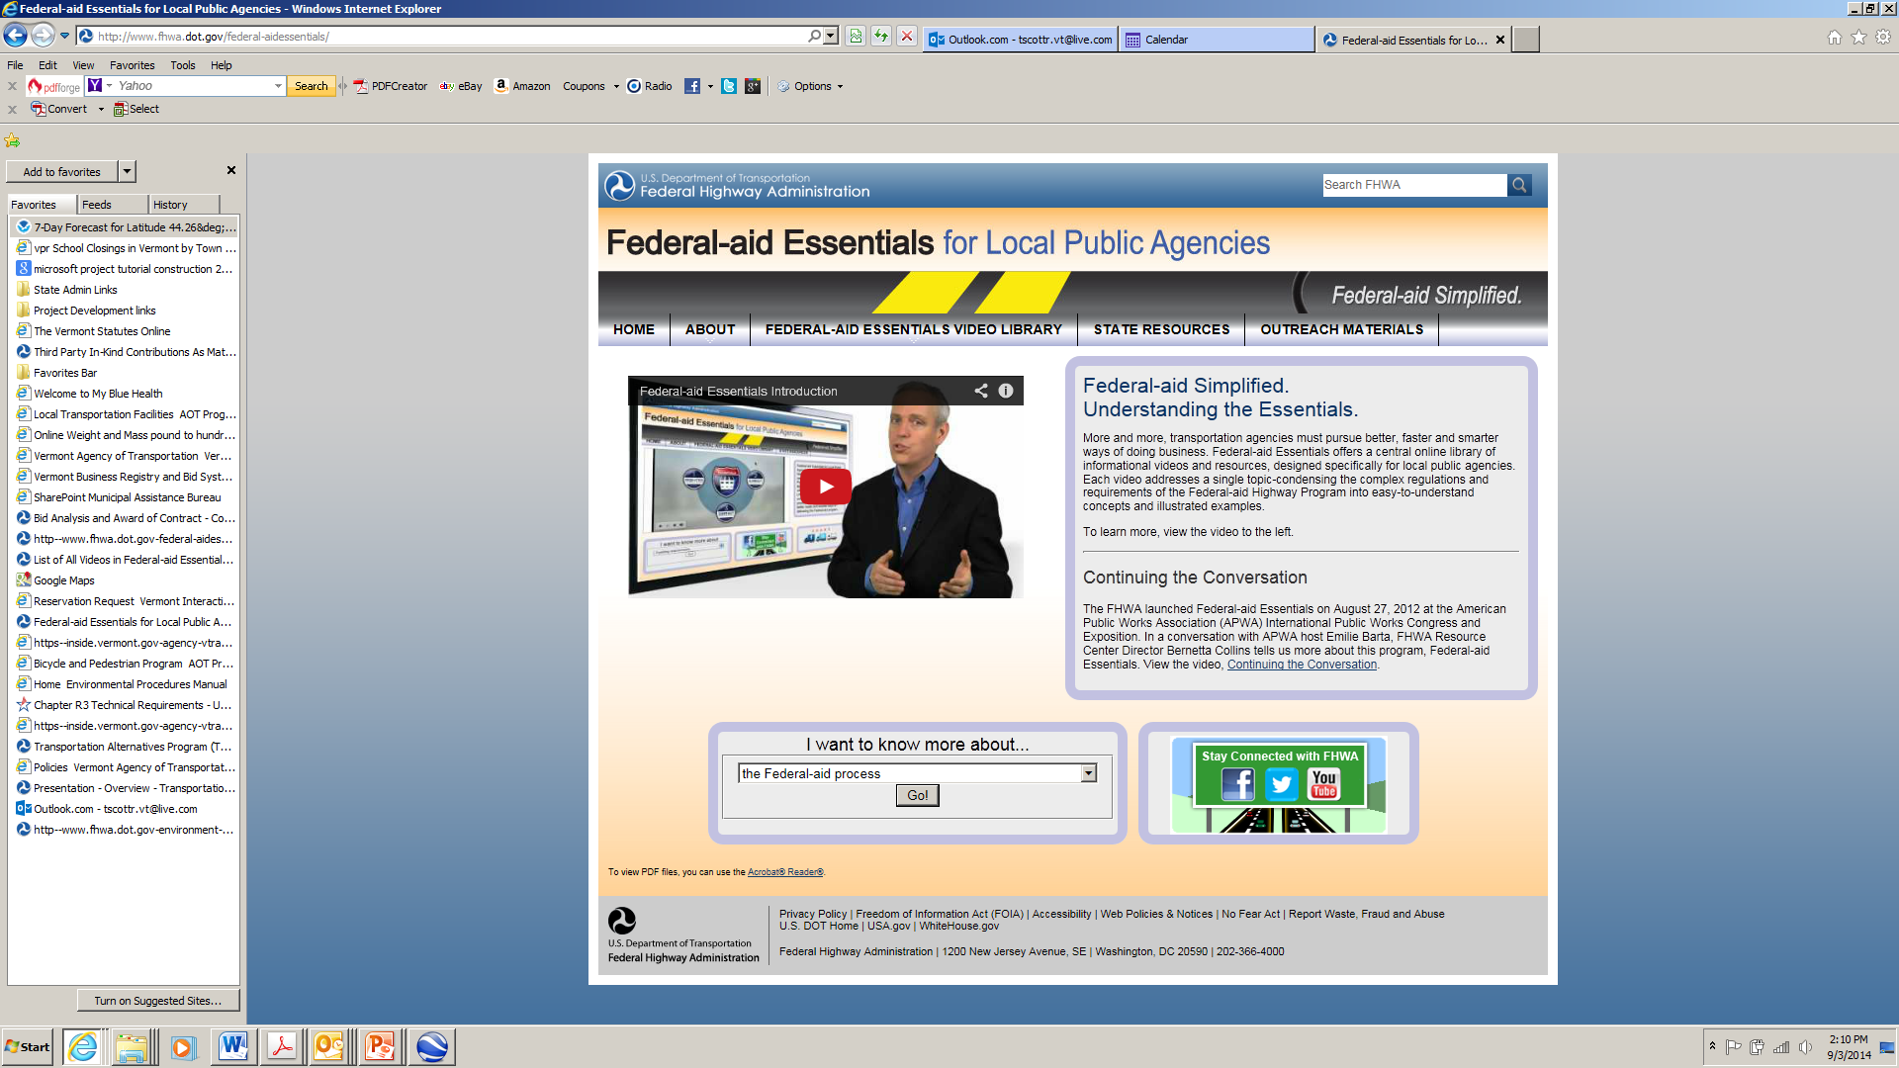
http://www.fhwa.dot.gov/federal-aidessentials

Slide 6
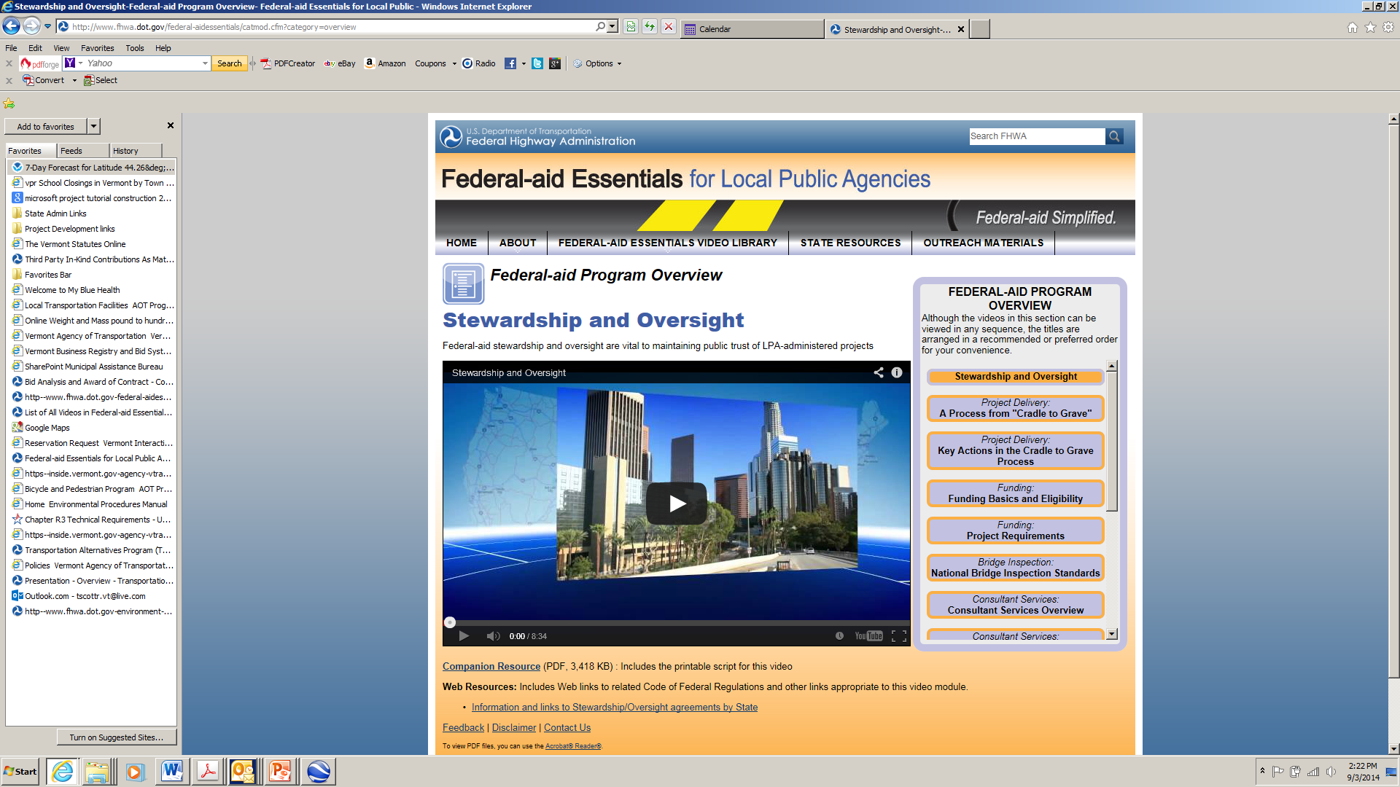

Slide 7
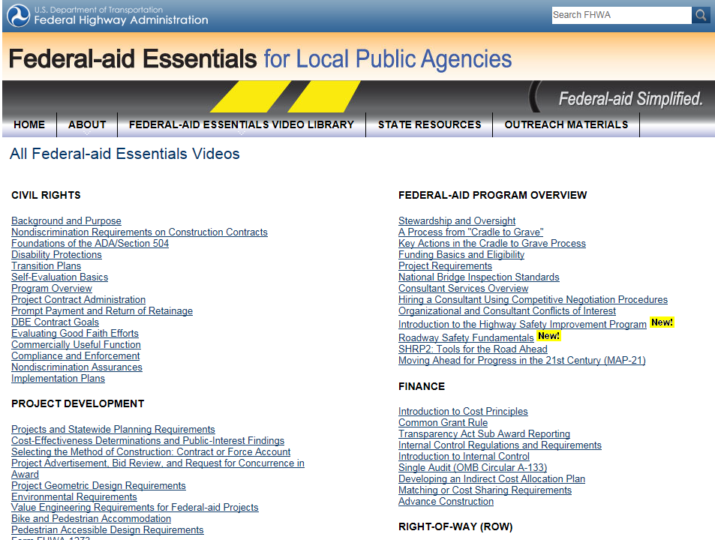

Slide 8
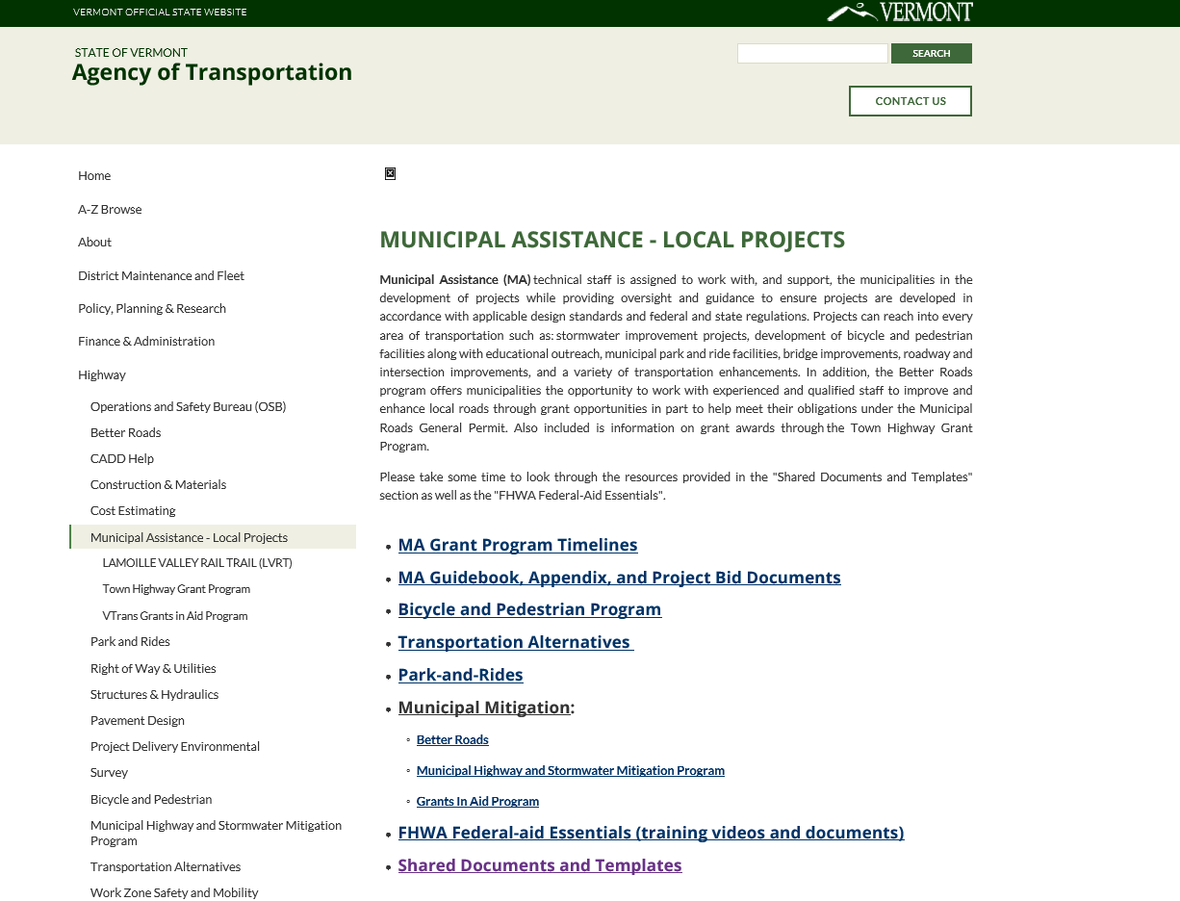

Slide 9
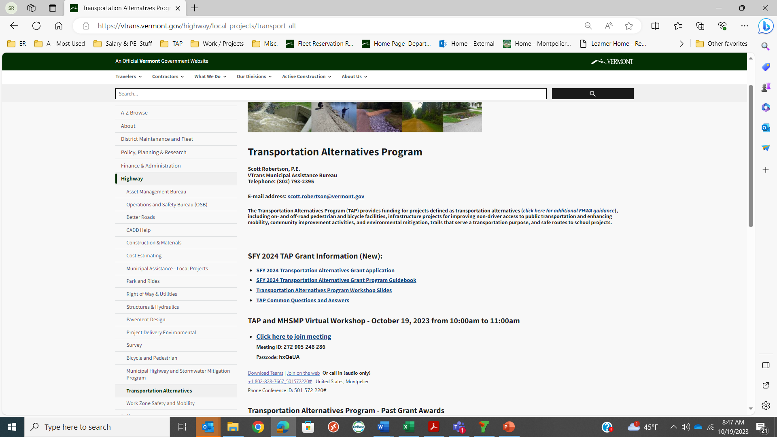

Slide 10
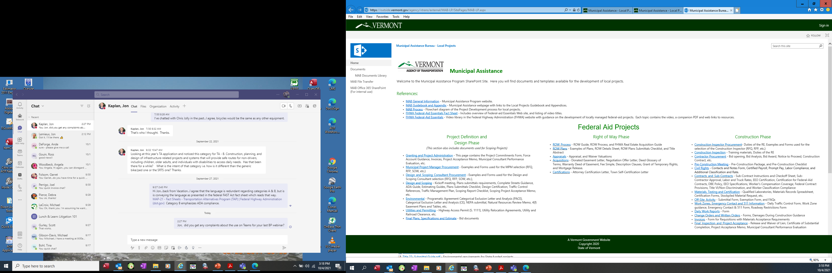

Slide 11
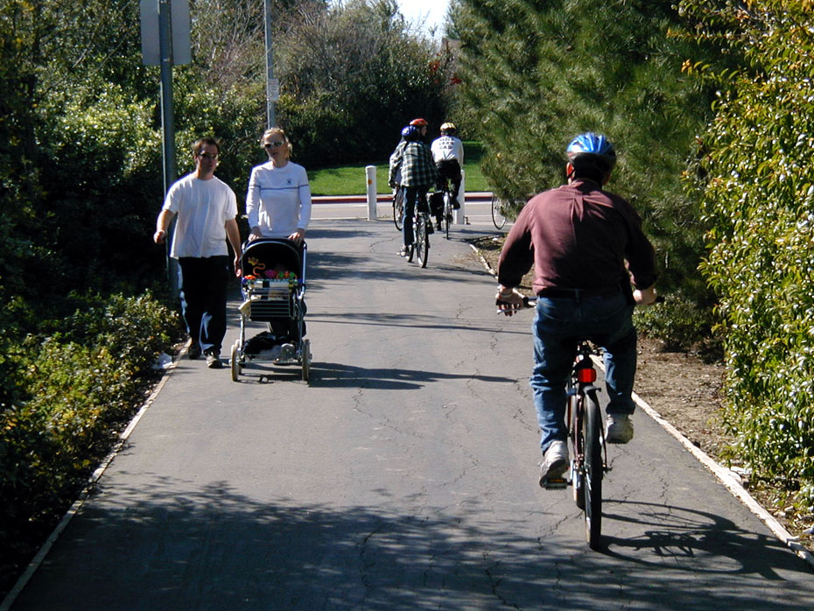

Eligible Applicants
Local Governments - City, Town, Village
Regional Transportation Authority
Transit Agency
Natural Resource or Public Land Agency
School District
A Tribal Government
MPO
A Non-Profit Entity
Any other local or regional governmental entity with responsibility for or oversight of transportation or recreational trails
State (at the request of an eligible entity listed above)

Slide 12
Eligible Projects
A) Construction, planning, and design of on-road and off-road trail facilities for pedestrians, bicyclists, and other non-motorized forms of transportation.
      Sidewalks
      Bicycle and Pedestrian infrastructure
      Pedestrian and bicycle signals
      Traffic calming techniques
      Lighting and other safety-related infrastructure
      Transportation projects to achieve compliance with the Americans with Disabilities Act of 1990.
Notes:
Before: Identical to what you see in the TA Announcement letter
After: Traffic calming techniques - roundabouts, bulb-outs, center islands, etc.

Slide 13
Eligible Projects (continued)
B) Construction, planning, and design of infrastructure-related projects and systems that will provide safe routes for non-drivers, including children, older adults, and individuals with disabilities to access daily needs.
C) Conversion and use of abandoned railroad corridors for trails for pedestrians, bicyclists, or other non-motorized transportation users.
D) Construction of turnouts, overlooks, and viewing areas as described in 23CFR 752.6.

Slide 14
Eligible Projects (continued)
E) Community improvement activities, including:
(i) Historic preservation and rehabilitation of historic transportation facilities.
(ii) Vegetation management practices in transportation rights-of-way to improve roadway safety, prevent against invasive species, and provide erosion control.
(iii) Archaeological activities relating to impacts from implementation of a transportation project eligible under this title.

Slide 15
Eligible Projects (continued)
F) Any environmental mitigation activity, including pollution prevention and pollution abatement activities and mitigation. Potential project ideas may include, but not be limited to:
(i) address stormwater management, control, and water pollution prevention or abatement related to highway construction or due to highway runoff, including activities described in sections 23 USC 133(b)(11), 328(a), and 329
(ii) reduce vehicle-caused wildlife mortality or to restore and maintain connectivity among terrestrial or aquatic habitats.

Slide 16
TAP Opportunities for Stormwater
Mitigation Funding!!
50% of SFY 2023 TAP funding (over $2 mil.) is reserved for applications addressing Environmental Mitigation efforts relating to stormwater and highways.
Sand/salt shed construction projects are eligible.
Potential project ideas may include, but not be limited to:
Bio-filters Culvert replacement / re-sizing
Ditching Infiltration Basins
Stormwater Planning Studies Check Dams
Bank Stabilization Swirl Separators
Phosphorous control plans Phosphorus Control Studies
Salt Sheds Permeable Pavers
Bio-Retention Systems Gravel Wetlands
http://vtrans.vermont.gov/highway/local-projects/transport-alt

Slide 17
Appendix C: Municipal Assistance Section – Salt Shed Grant Application Guide
(Applies to grant applications received after July 1, 2022)
VTrans - Municipal Assistance Section grant opportunities allow for the design and construction of salt and sand sheds as eligible expenses through the following programs: the Transportation Alternatives Program (TAP) and the Municipal Highway and Stormwater Mitigation Program (MHSMP). Salt shed funding is allowed through these programs to mitigate water contamination in association with the Vermont Clean Water Act (Act 64). All projects must be developed in accordance with applicable federal and state regulations.
The purpose of this funding is to effectively cover salt and sand piles to prevent water pollution. This funding is eligible for a reasonably sized sand/salt shed and allows for the storage of necessary loading equipment. Additional equipment storage, general maintenance of existing salt sheds, or any other amenities are not eligible. Salt and sand sheds that have exceeded their expected useful life is not considered maintenance and may be eligible to apply for this funding.

Slide 18
Continued…
The maximum amount of funding per project through the VTrans Municipal Assistance Section (i.e., the sum total of MM and TAP grants) is capped at $500,000 of federal funding which will require $125,000 of local match funding, for a total grant amount of $625,000 (i.e., 80% federal or state / 20% local funding split). Any additional expenses per project cannot be funded through these programs.
The MHSMP and TAP programs require the following elements to be addressed to successfully receive grant funding:
A thorough description of how salt contamination is occurring from the existing salt pile conditions to nearby surface and/or ground water (including the proximity of the closest receiving waters and/or other sensitive resources, such as wetlands).
Evidence of salt and sand shed size necessity and annual salt & sand usage.
A thorough cost estimate of the design and construction of the facility meeting federal requirements. o Must include considerations for project design, R.O.W., construction, construction inspection, and project management expenses.

Slide 19
Continued…
A review of existing permits relative to the improvement, a statement of how the project will comply, and if any new permits will be required.
A support letter from the governing body of the applicant municipality or organization must include:
  Acknowledgement of the local match financial requirement.
  Acknowledgement of responsibility for future maintenance costs.
A support letter from the Regional Planning Commission (RPC).
A letter of acknowledgement from the VTrans District Transportation Administrator if the project requires a State Highway Work and Access Permit.

Slide 20
Projects That Are No Longer Eligible
Historic preservation of something not considered a historic transportation facility or structure.
Operation of historic transportation facilities
Stand-alone landscaping projects other than for vegetation management nor those considered “beautification”
Archaeological activities not addressing impacts from a transportation project
Notes:
These are projects that were previously eligible in the TE program

Slide 21
Projects That Are No Longer Eligible
Acquisition of scenic easements and scenic or historic sites
Visitor and Welcome Centers
Transportation Museums
General safety and educational activities
Notes:
These are projects that were previously eligible in the TE program

Slide 22
Program Overview
Can apply for either Scoping or Design & Construction
20% local match required for scoping
20% local match required for design/construction
Maximum award $600,000 federal dollars
Award amount is capped
If Design/Construction project does not advance, payback may be required.
TAP application available at:
  https://vtrans.vermont.gov/highway/local-projects/transport-alt
Notes:
Revised LP guidebook has a section on scoping studies.

Slide 23
TAP is a Reimbursement Program
NOT a block grant
Project sponsor pays contractor
Project sponsor submits invoice to VTrans
VTrans reimburses project sponsor federal portion of eligible costs
Notes:
Invoice submittal practices are described in the guidebook for required receipts and budget tracking.

Slide 24
Program requires…
Compliance with State and Federal Regulations
Compliance with Agency and National Design Standards
Municipal Project Management
Maintenance of the improvement by sponsor

Slide 25
Project Development Process
Your project will be developed according to a specific development process which includes:
A public involvement process
Environmental resource considerations
Development and selection of a Preferred Alternative
Designing the facility
Acquiring the necessary property rights
Procuring and executing construction
Notes:
Preferred Alternative is where Scoping Study ends.

Slide 26
Three Phases of a Federal-Aid Project
PE - Preliminary Engineering
ROW - Right of Way
Construction

Slide 27
Preliminary Engineering (PE)
Designate or procure a Municipal Project Manager (MPM)
Procure a design consultant
Identify and clear natural and historical resources. Obtain NEPA document.
Design the project (including erosion and stormwater control if needed).
Notes:
Project Management can overwhelm town staff

Slide 28
Environmental Resources and Permitting
Documentation of environmental issues is a federal requirement.
  for most projects like these, it is a Categorical Exclusion (CE)
Will need Historic resource (above ground) and Archaeological resource (below ground) clearances.
If wetlands/waterways are involved, the Corps of Engineers may have jurisdiction.
Erosion Prevention and Sediment Control (during construction) and Stormwater Plans (post-construction) is required.
Notes:
The PDP includes an comprehensive environmental component / eveluation.

Slide 29
Right of Way (ROW)
All ROW activities and acquisitions must conform with federal requirements (the Uniform Act).
Identify construction limits of project to determine property ownership.
Establish fair market value for property.
Negotiate price for easement, lease or fee acquisition with landowner.
Purchase, lease, or obtain by donation.
Obtain ROW Certification from VTrans.
Notes:
The VTrans PM will assist the MPM as needed in this process

Slide 30
Construction:
Construction projects require open competitive bidding through an Invitation For Bid (IFB) process. Lowest responsive bid by responsible bidder must be accepted.
Erosion Control and Stormwater Plans Required.
Materials testing and certifications are required.
Construction Inspection is Required.
Notes:
Guidebook describes different levels of bidding requirements/practices based on the amount of the contract.

Slide 31
Construction Inspection
The project sponsor is responsible for the continuous inspection of the construction.
Typically, this is done by a hired construction inspection engineering consultant/firm.
Be sure that your project budget includes this service.
Notes:
If, at final inspection, we find that steel is marked – made in India or Canada, then we will have project complications. Buy America will be in upcoming slides.

Slide 32
Typical Project Costs
Use the latest VTrans Bike/Ped Facility Unit Cost Report:
https://vtrans.vermont.gov/sites/aot/files/highway/documents/ltf/VTrans%20Path%20and%20Sidewalk%20Cost_Report_2020.pdf
to cross-check construction a variety of costs.
Total budget should include the cost of:
  Engineering (roughly 20% of construction)
  Project Management (roughly 10% of overall)
  Right of Way (highly variable)
  Construction Inspection (10% – 20% of Constr. +/-)
  Construction
Notes:
ROW- complexity depends on number of properties and how many of those properties require appraisals rather than waiver valuations.

Slide 33
Project Cost Example
Project Activity | Cost
Preliminary Engineering (PE) (Costs associated with planning, engineering/design, survey, permitting, public input and coordination) – Typically between 10% and 30% of the Construction Cost | $25,000
Right-of-Way (ROW) (Includes cost of appraisal, land acquisition and associated legal fees.) | $5,000
Construction (Construction costs including a reasonable contingency) | $250,000
Construction Inspection (Cost to provide oversight during construction – typically 10% to 20% of Construction cost) | $30,000
Administration (Cost associated with municipal oversight of the project, estimated to be a minimum of 10% of total PE, ROW and Construction phases.) | $30,000
Other (Please explain)
Total | $340,000
Federal Dollars requested in Application (0.8 * $340,000) | $272,000
Local Match (0.2 * $340,000) | $68,000

Slide 34
Scoping Study Costs
Scoping studies typically cost between $40,000 and $70,000 (total).
Cost depends on the number of alternatives to be evaluated and/or the extent of the geographic area covered by the study.
Expected to follow the outline developed by VTrans and to use professional engineers/planners.

Slide 35
Eligible Local Match
Direct Payment from Sponsor
  Local ARPA funding alllowed
Donated materials or services (but must be pre-approved). Must be found to be necessary for the project.
The value of donated Right-of-Way

Slide 36
Non-Eligible Local Match
Cannot be other FHWA funds. Any federal funds from other grant sources are typically not allowed.
Costs incurred prior to having an executed agreement with the Agency
Pre-application costs are not eligible

Slide 37
Regional Planning Commission Support
A letter of support is required from the Regional Planning Commission for each application.
All projects must conform with the Regional Transportation Plan.

Slide 38
District Transportation Administrator (DTA)
If your project is within or directly adjacent to a State maintained Highway…
You must document notifying your VTrans District Transportation Administrator about your project and include any comments in your application.

Slide 39
Regional Planning Commission Support
A letter of support is required from the Regional Planning Commission for each application.
All projects must conform with the Regional Transportation Plan.

Slide 40
Requirements
Buy America (steel & ironproducts)
Davis Bacon Federal Wage Rates
Proprietary Products not allowed without Public InterestFinding
Project must be design and constructed in accordance with all federal/state/local permits and regulations

Slide 41
Work by Municipal Forces
Force Account work by a municipality:
  Where municipal services and labor are used instead of contracting).
  This is meant to be the exception and not the rule. Town must present information to justify and seek approval.
  Required even when town proposes completing a small amount of work to offset their match requirements for the project.

Slide 42
Elements of a Competitive Application
Strong connection with the transportation system
Addresses one or more of program eligible categories
Well-planned – helpful if project has a scoping study completed
Strong public support
Realistic, well-developed budget
Concisely and articulately written

Slide 43
Application Scoring Criteria
Give a brief description of the project
  Indicate the primary facility type being applied for
  10 points max.
What is the feasibility of this project?
  Scoping study applications - not scored on this criterion.
  Describe the extent of project development completed to date.
  10 points max.
Does this project address a need identified in a local or regional planning document?
  5 points max.

Slide 44
Application Scoring Criteria (continued)
Does this project:
Benefit a State Designated Center per the link below (i.e.,
downtowns, villages, or neighborhood growth centers recognized
by the Vermont Department of Economic, Housing and
Community Development?
Not applicable for Environmental Mitigation Categories (5 points max.)
http://maps.vermont.gov/ACCD/PlanningAtlas/index.html?viewer=PlanningAtlas
Benefit mobility for disadvantaged populations to include elderly,
disabled, minorities, and low-income residents.
Please describe this impact (if applicable) in detail. Supporting
documentation, including recent data must be included.
Not applicable for Environmental Mitigation Categories (10 points max.)

Slide 45
Application Scoring Criteria (continued)
Provide a project cost estimate (total):
  Project costs include both federal dollars and local dollars.
  For scoping studies, use PE and Municipal Project Management lines only on the application form
  Include supporting information and other funding sources.,
  10 points max.

Slide 46
Category Specific Scoring Criteria
Select the eligibility category below (A, B, C or D) that best fits your project and answer the corresponding questions for that category (choose only one category).
A. Bicycle and Pedestrian Facilities
B. Community Improvement Activities
Environmental Mitigation-Stormwater
Environmental Mitigation - Wildlife
Notes:
The nest few slides will describe these categories

Slide 47
A. Bicycle and Pedestrian Facilities
(i) Will the project contribute to a system of pedestrian and/or bicycle facilities? (10 points max.)
(ii) Will the project provide access to likely generators of pedestrian and/or bicyclist activity? (10 points max.)
(iii) Will the project address a known, documented safety concern? (10 points max.)
  *10 bonus points will be awarded for projects that are primarily Bicycle or Pedestrian facilities.

Slide 48
B. Community Improvement Activities
(iii) Answer only one of the following based on the type of project:
  Construction of turnouts, overlooks, and viewing areas as related to scenic or historic sites.
    To what extent will the project provide a view of a highly unique and scenic area? (10 points max.)
  Preservation or rehabilitation of historic transportation facilities.
    Describe the historic significance of the historic transportation facility and the importance of the facility to the State.(10 points max.)
  Archeological planning and research related to impacts from a transportation project.
    Describe the associated transportation project and benefit of the proposed activities. (10 points max.)
  Vegetation management in transportation rights of way to improve roadway safety, prevent against invasive species, and provide erosion control.
    Describe the extent of the current problem; impact on the site and surrounding area. (10 points max.)

Slide 49
C. Environmental Mitigation - Stormwater
  (i) Please describe how this application provides environmental mitigation relating to stormwater and highways. (10 points max.)
(ii) What information or data is provided to substantiate the current stormwater problem and associated environmental impacts? (10 points max.)
(iii) What substantiating data or information is provided to show that the proposed application is an effective and manageable solution to the problem? (10 points max.)

Slide 50
D. Environmental Mitigation - Wildlife
  (i) Please describe how this application provides environmental mitigation relating to wildlife mortality. (10 points max.)
(ii) What information or data is provided to substantiate the current wildlife problem and associated environmental impacts? (10 points max.)
(iii) What substantiating data or information is provided to show that the proposed application is an effective and manageable solution to the problem? (10 points max.)

Slide 51
If your project is funded:
TAP Funding is competitive. If funded, you will be asked to complete and sign a Project Commitment Letter that includes:
  Acknowledgement that you are responsible for providing the local share of the project funding and commit to doing so.
  Commitment to move forward with this project and sign the Grant Agreement within one month of receiving the document.
Notes:
We have experienced significant lag periods in the in project authorization and the PDP which have severely prolonged projects … which causes complications and sometimes funding withdrawal.

Slide 52
Project Development Timeline Example
February 2023 – Announcement of grant awards
March 2023 – Grant agreement executed
June 2023 – Engineering/MPM Procurement process complete
March 2024 – Conceptual Plans and NEPA document secured
September 2024 – Preliminary Plans completed
June 2025 – Right of Way approved and cleared
February 2026 – Final plans and bid documents completed
May 2026 – Project goes out to bid for Construction

Slide 53
Scoping Study Timeline Example
February 2023 – Announcement of grant awards
March 2023 – Grant agreement executed
May 2023 – Consultant Procurement process complete
October 2023 – Draft Study/Alternatives Presentation
January 2024 – Scoping Study completed

Slide 54
Common Mistakes
“We always know who to hire!”
“We’ve got plans; let’s go to construction!”
“I’m sure we can handle the MPM role internally.”
“The guy from ANR said “no problem…”
“We don’t need any Right-of-Way…”
“Can’t we just rely on our contractor to know what needs to be done?”

Slide 55
Successful Projects
Hire qualified professionals
HAVE GOOD AND CONTINUAL COMMUNICATION WITH VTRANS
Have realistic project cost estimates and schedules when applying
Have the full support of the town

Slide 56
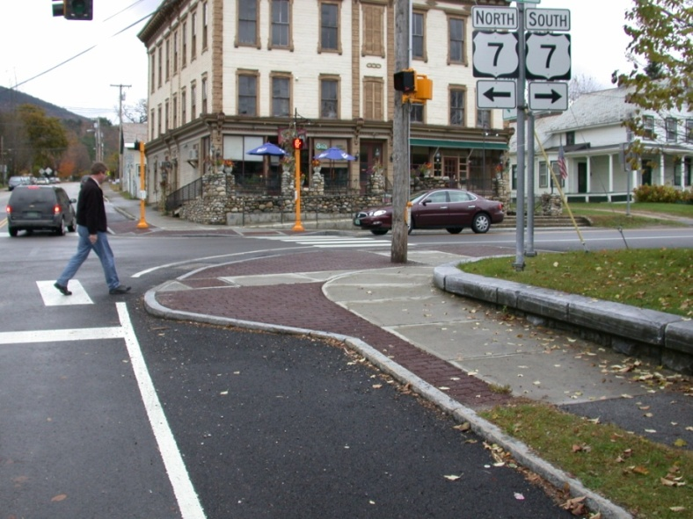
Project Examples
Notes:
Summary:
Universal design provides for the comfort of all users.
Message:
The concept of universal design is to provide an environment that is equally accessible and comfortable for users of all ages and abilities. A pedestrian facility is not truly usable if it cannot be used by the very old, the very young, or by members of the disabled community.
Image(s):
provided by Peter Lagerwey

Slide 57
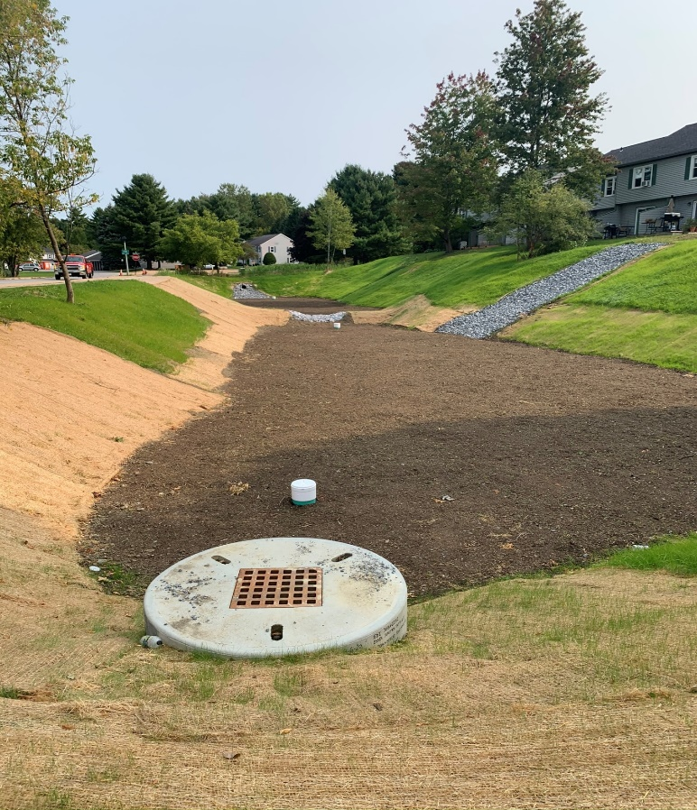
Stormwater Quality Improvement is the goal
Notes:
Summary:
Universal design provides for the comfort of all users.
Message:
The concept of universal design is to provide an environment that is equally accessible and comfortable for users of all ages and abilities. A pedestrian facility is not truly usable if it cannot be used by the very old, the very young, or by members of the disabled community.
Image(s):
provided by Peter Lagerwey

Slide 58
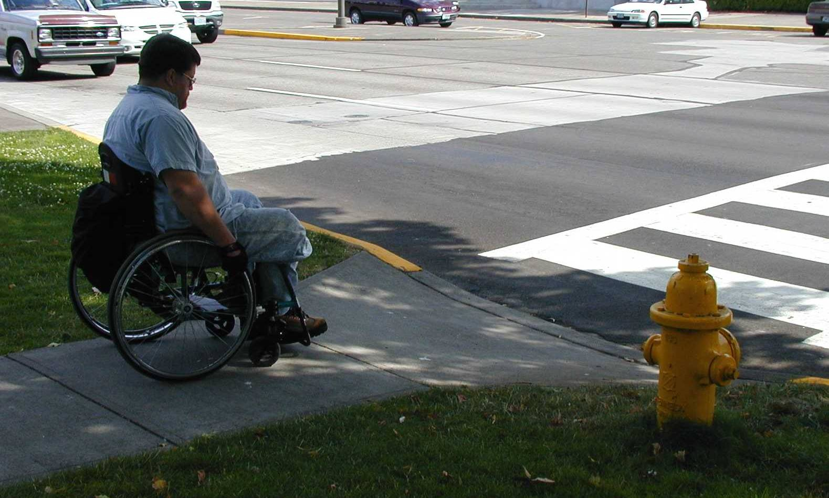
Meet ADA requirements for universal design
Notes:
Summary:
Universal design provides for the comfort of all users.
Message:
The concept of universal design is to provide an environment that is equally accessible and comfortable for users of all ages and abilities. A pedestrian facility is not truly usable if it cannot be used by the very old, the very young, or by members of the disabled community.

Slide 59
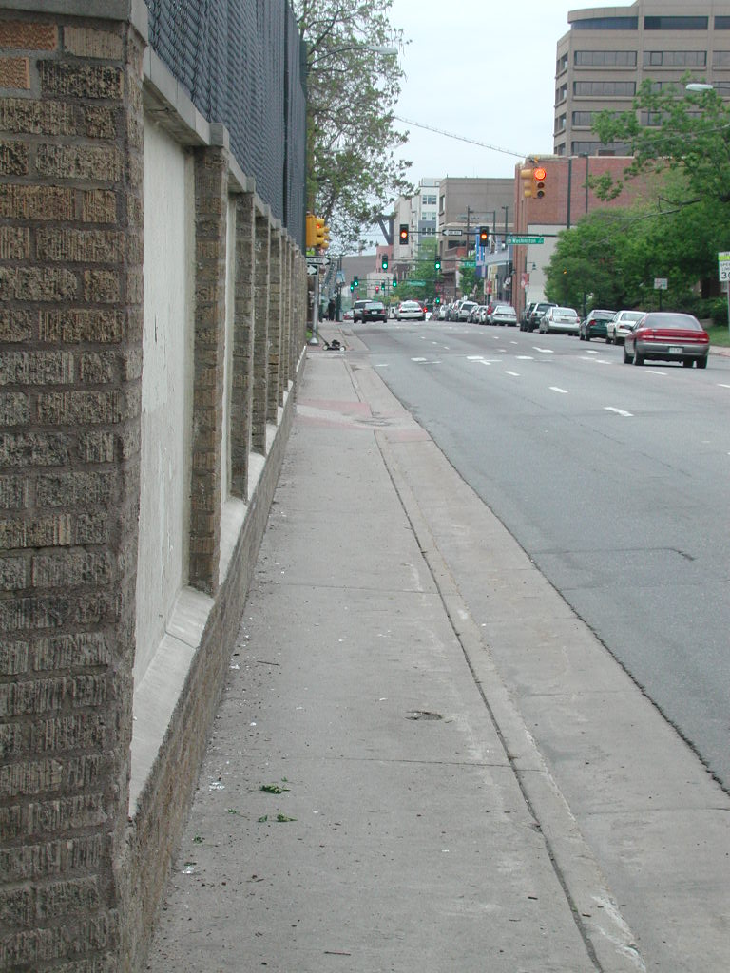
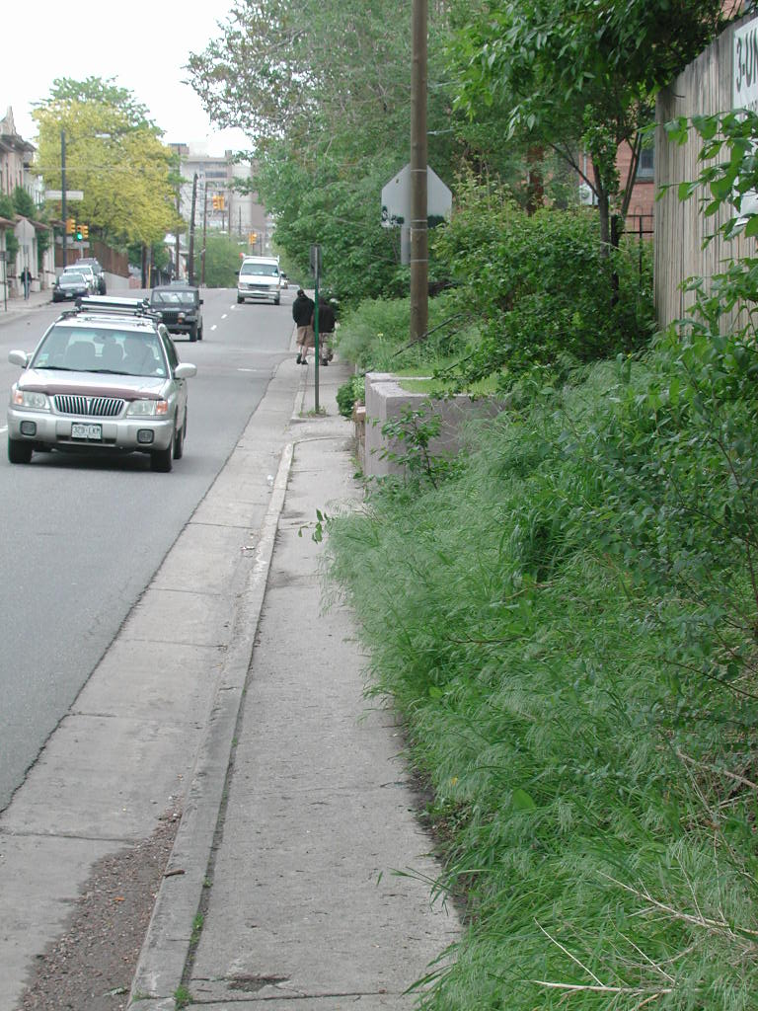
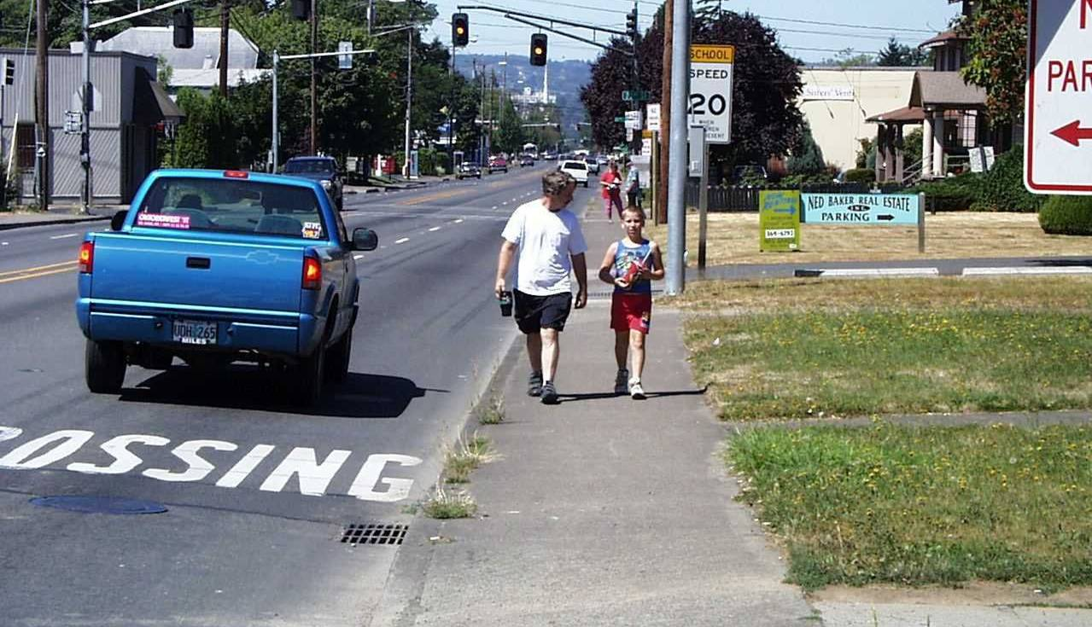
Narrow curbside sidewalks provide no buffer
Notes:
Instructor Note: 5-foot curbtight sidewalk is uncomfortable next to traffic. Notice that even the driver doesn’t feel comfortable passing pedestrians so closely, and moves further from curb.
Salem, Oregon

Slide 60
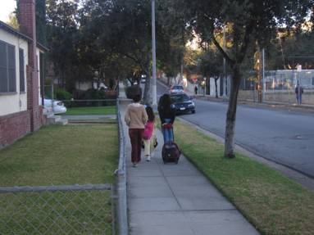
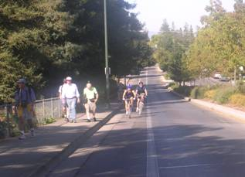
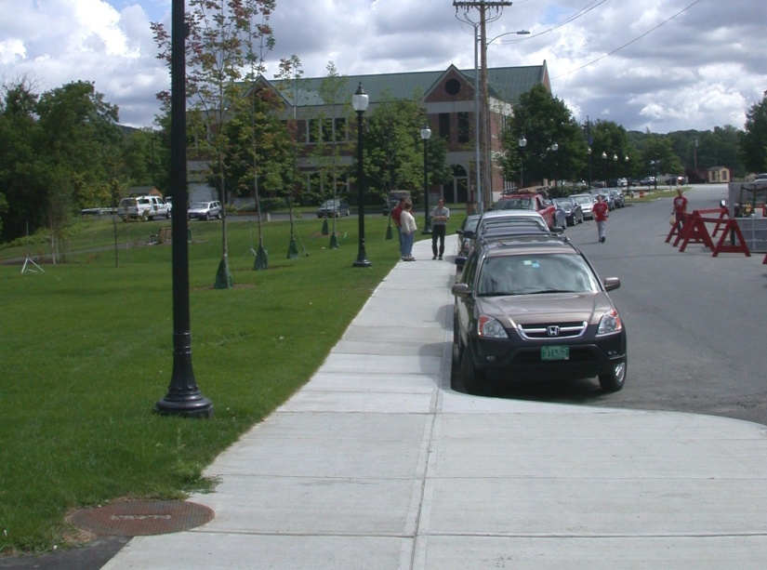
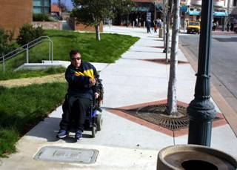
Provide buffer from travel lanes
Green Strip
Bike Lanes
2 ft. min. – wider preferred
5 feet min. to plant trees
On-street Parking
Landscaping
Notes:
Summary:
There are four general types of buffers.
Message:
There are four typical types of sidewalk buffers:
1 – (PREFERRED) planting strip – grass and trees
2 – Bike lane – if you can’t have a planting strip, a bike lane can provide a buffer between pedestrians and motor vehicles
3 – Parked cars – Parked cars can provide a buffer between pedestrians and motor vehicles
4 – Street furniture: benches, newspaper boxes, street lighting, public art
Image(s):
provided by Peter Lagerwey and Dan Burden

Slide 61
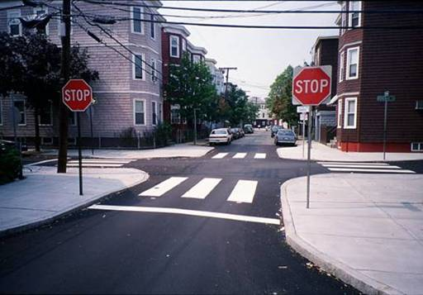
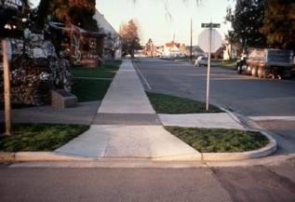
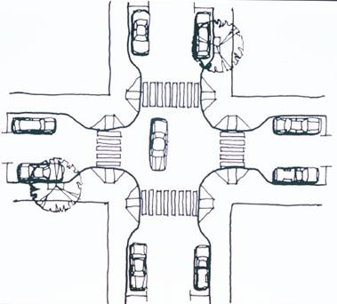
Curb extensions at crossings
Reduce the crossing distance
Allow better sight lines
Improve visibility of pedestrians
Narrower road reduces speed
Notes:
Summary:
Curb extensions reduce crossing distance, calm traffic, raise traffic awareness, and are a proven safety benefit.

Slide 62
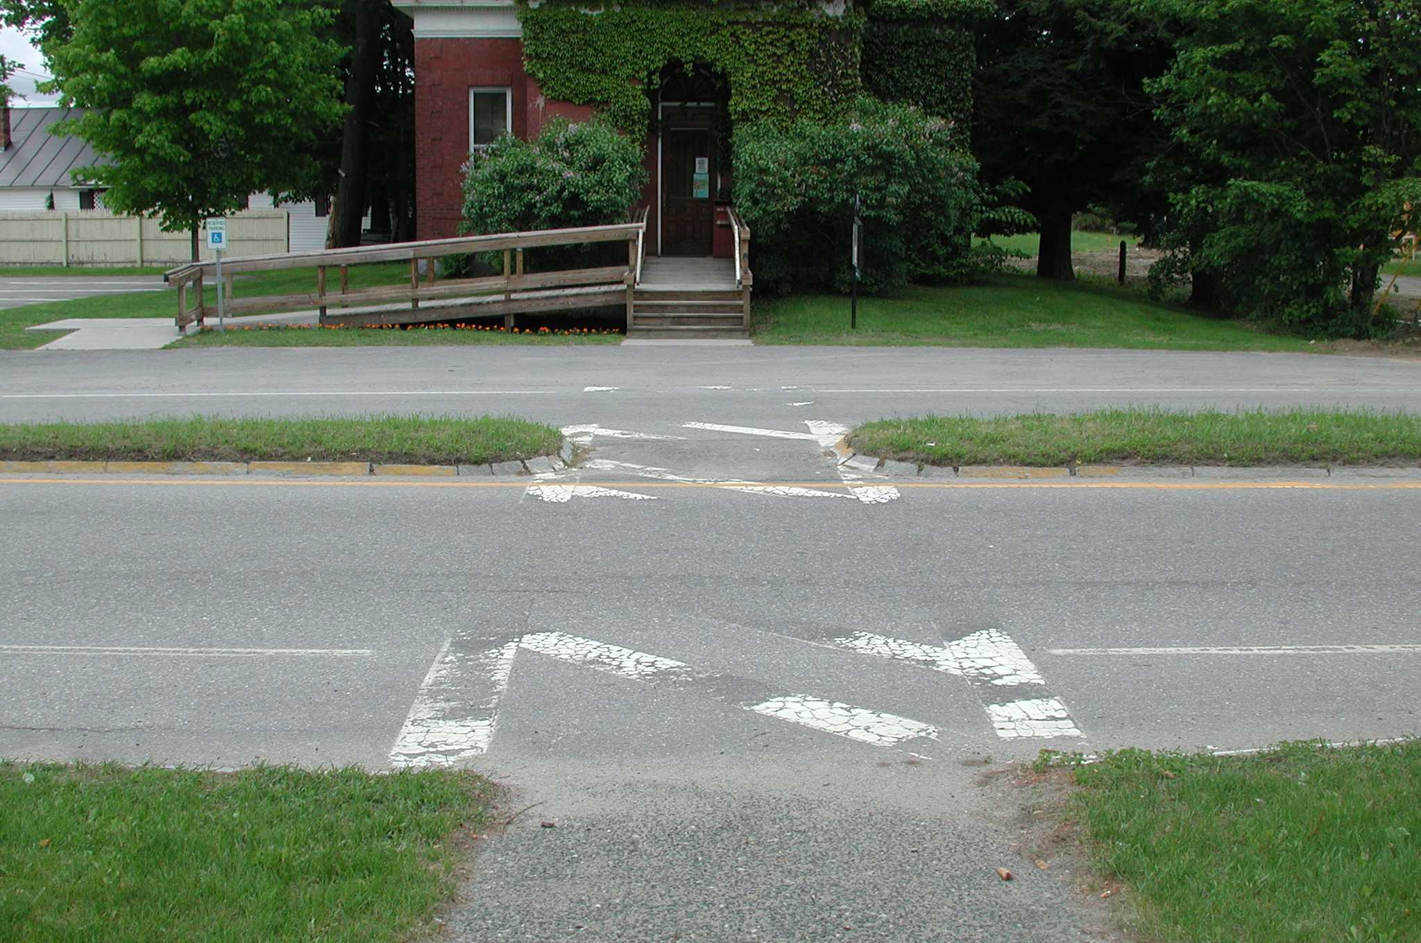
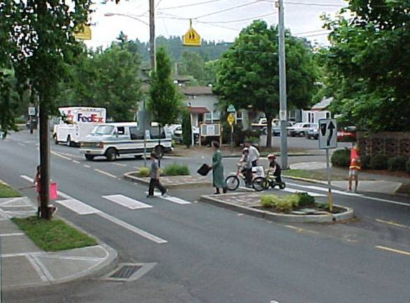
Cut-through Medians or Islands Work Well
Guidance on use:
AASHTO Pedestrian Guide – “crossing islands should be considered where the crossing distance exceeds 60 feet, but can be used at intersections with shorter crossing distances where a need has been recognized.”
Photo credit: Dan Burden
Recommended by Federal Highway as a proven pedestrian safety countermeasure

Slide 63
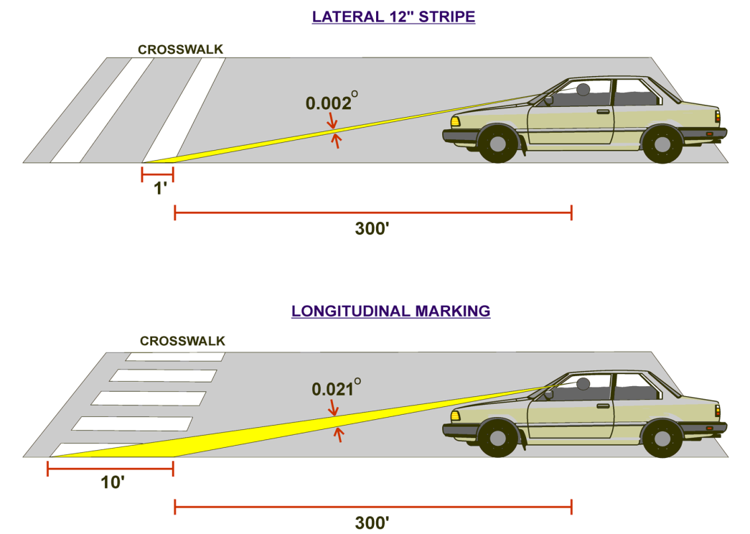
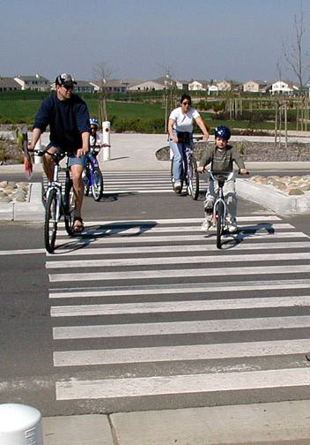
Install High-Visibility Markings
Block Style: more visible than two parallel lines
Notes:
Summary:
Install high visibility markings
Message:
Marked crosswalks guide pedestrians to a crossing location, and they also alert motorists to the crossing location. Therefore, it’s important that both motorists and pedestrians clearly see the crossings. Marked crosswalks should always be 10 feet wide, preferably 12 feet. Ladder-style markings are more visible than simple parallel lines. It is good to have skid-resistant paint lines.
Image(s):
(t.) Dan Burden, on PBIC web site (b.r.) provided by Peter Lagerwey, on PBIC web site

Slide 64
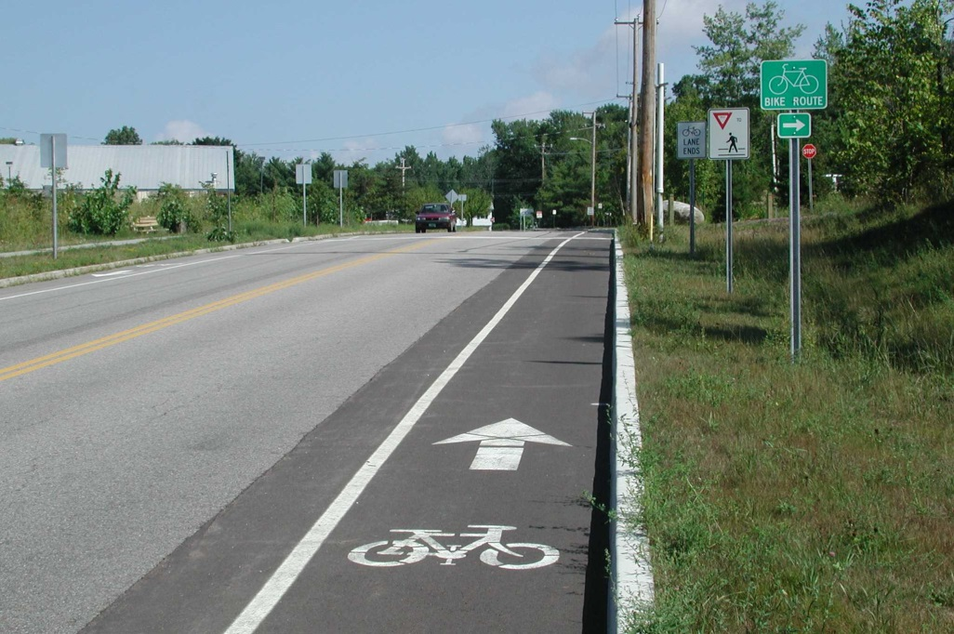
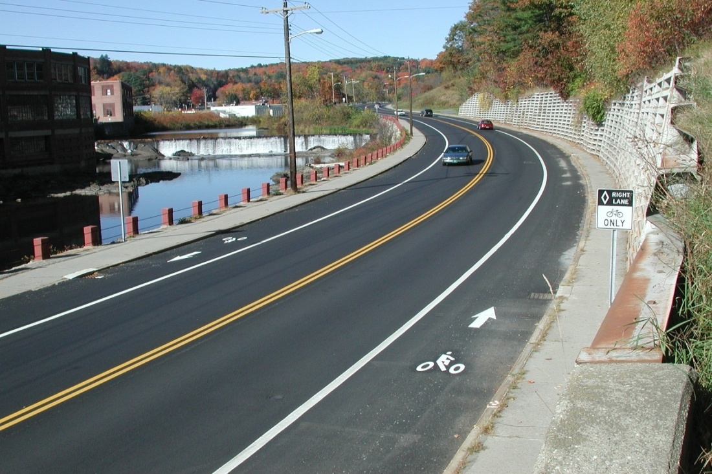
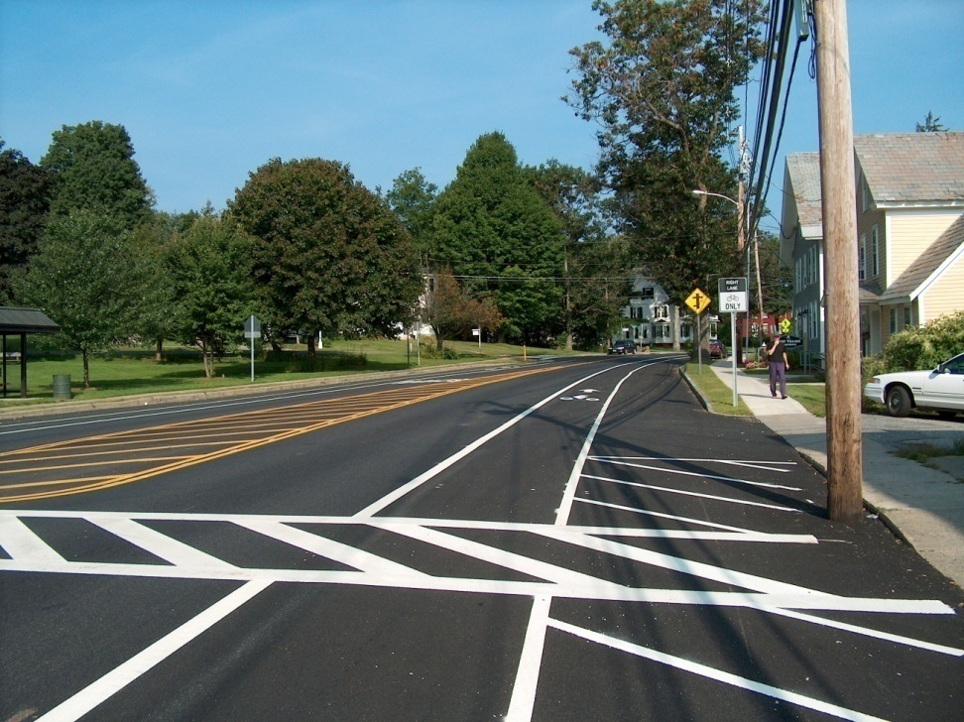
Bicycle Lanes
So. Burlington, VT
Springfield, VT
W. Brattleboro, VT
Intended for congested areas
Minimum 4’ wide
Pavement markings and signs
Notes:
Summary:
Bicycle lanes increase use and provide comfortable place for novice and inexperienced bicyclists to ride.
Message:
Typically, bike lanes next to parking should be 5 ft wide. Preferred width of bicycle lanes next to a curb is also 5 ft, although 4 ft may be adequate (excluding the gutter apron). Bicycle lanes should be designated through the use of signs or painted symbols and parking restrictions. A 6-ft-wide bike lane may create problems, as sometimes cars may use a 6 ft bike lane as a travel lane.
Image(s):
(l.) provided by Peter Lagerwey

Slide 65
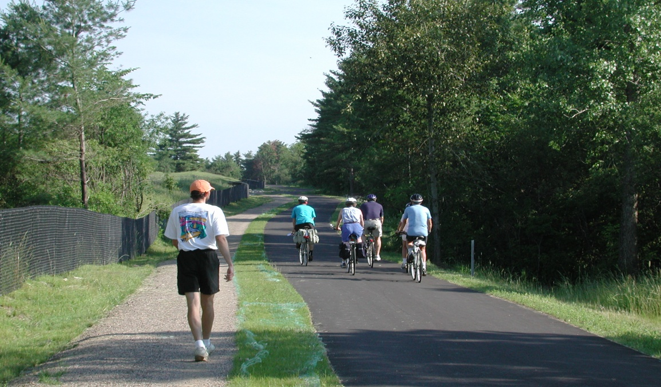
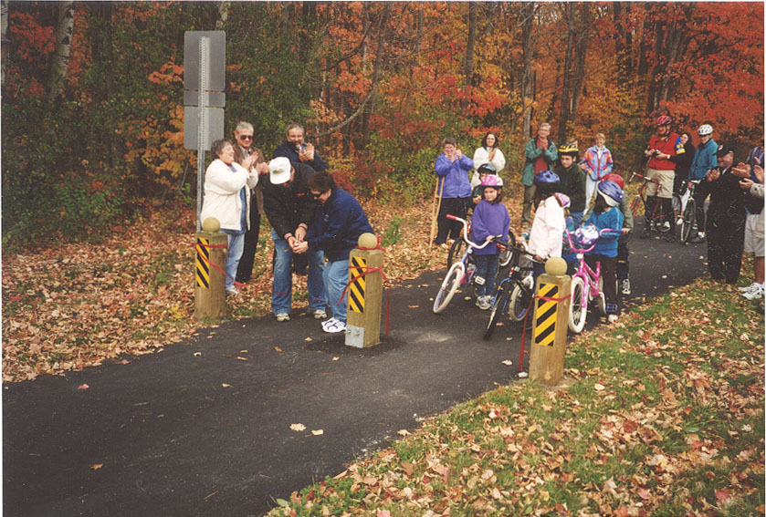
Shared use paths
Standard width – 10’ (min).
Multiple users
On independent alignment
So. Burlington, VT
Good when providing a short cut or alternative to high volume road
Complements the street system
Complex project development
Wilder, VT
Notes:
Summary:
Separated multi-use pathways can also be an effective option at many schools for creating safer routes.
Message:
There are locations where separated paths are appropriate and can greatly shorten the distance for children to walk or bike to school, such as to connect neighborhoods directly with schools. However, separate walkways must be designed properly where they intersect public roadways to minimize the risk of pedestrian/bicyclist crashes. Providing separate pathways can certainly be part of the network for child pedestrians and bicyclists, along with sidewalks. Guidelines for designing paths and trails are given in the 1999 AASHTO Guide for the Development of Bicycle Facilities. * In this slide is an example of a pathway that was funded by California’s SR2S program.
Background:
*Guide for the Development of Bicycle Facilities, American Association of State Highway and Transportation Officials, Washington, D.C., 1999, available online at http://safety.fhwa.dot.gov/fourthlevel/pdf/b_aashtobik.pdf, accessed September 14, 2004.
Image(s):
(t.r.) provided by Dave Parisi, Edna Maquire School, Mill Valley, CA

Slide 66
QUESTIONS???
Scott Robertson, P.E. scott.robertson@vermont.gov
802-793-2395

