Slide 1
Research Overview including Research Ideas and Champion Solicitations
AOT Lunch and learn series, November 16, 2023
Emily Parkany, Research manager
Ashlie Mercado, research engineer
Vermont agency of transportation

Slide 2
Today
Research Overview
External Research Process
Submitting a Research Idea
Technical Research Champion Duties

Slide 3
VTRANS RESEARCH HIGHLIGHTS
Variety of projects: materials, structures, snow and ice, environmental, etc.—directly and indirectly research funded, other
Project Champions from across the Agency
Annual Research and Innovation Symposium—this year a Symposium Substitute Report
New communications—we want our research to be used so we need to share about our projects!

Slide 4
AOT RESEARCH OVERVIEW
When Research was part of the Materials Lab, there was more staff and more field and internal research.
Now, two staff and greater emphasis on research management
External research projects led by VTrans
Maximizing utilization of external payments
FHWA Pooled funds
National Cooperative Highway Research Program/TRB
Notes:
Slide Example A

Slide 5
2023 AOT Research and Innovation Symposium Lite
Due to July flooding, no in-person Symposium this year
Gathered Fact Sheets for 16 projects, 9 funded by Research and 7 external, separated into four groupings:
Materials and Pavements
Structures and Stormwater Design
Asset Management
Planning, Public Transportation, and Safety
Symposium Lite webpages: 2023 Research and Innovation Symposium Lite
Symposium Substitute Report with Research program overview and Fact Sheets available now! Symposium Substitute Report

Slide 6
AOT Research and Innovation Symposiums
26-30 Projects in Four Groupings:
Asset Management and Maintenance
Materials
Environmental, Resilience, Planning and Public Transportation
Structures and Construction
Virtual 2020, 2021, Hybrid 2022
Each project includes
Web page—permanently available!
Fact Sheet
Poster
3-5 Minute Recording (support team failed in 2022)
Half of the projects in 2022 included table demos

Slide 7
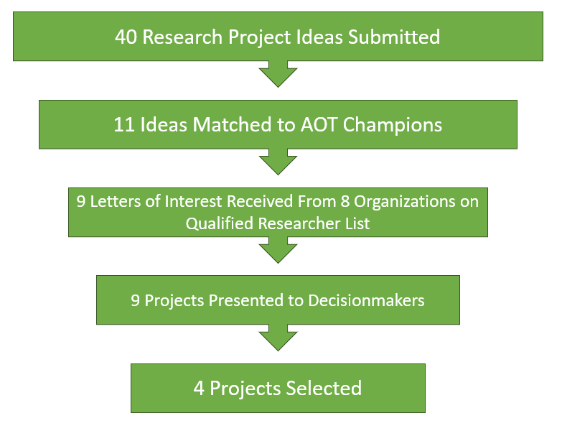
EXTERNAL RESEARCH PROCESS (VTRANS-LED)
Solicit research ideas by December each year (Dec 15 this year)
Match with VTrans technical Champions by early January
Champions prepare Research Project Statements in January
Solicit Letters of Interest from Qualified Researcher List in February
Qualified Researchers responded to RFP in December 2022
12 selected: 5 universities and 7 consultants
Champions select research teams based on Letters of Interest
Proposals due March 15
Champions present to Bureau Directors late March/early April who decide on projects to fund

Slide 8
2023 EXTERNAL RESEARCH PROJECTS (Potential and Funded)
Using DCP in Preliminary Design – Geotech
New UAS Technology Public Sector Impacts – Aviation
Small Culvert Performance Monitoring – District Maintenance
Travel Time Data from Work Zones – Proj Dev/Traffic Design
Pavement Performance Models – Asset Management
RAS as an FDR Mechanical Stabilizer – Asphalt Materials
Phosphorus Removal from Stone-Lined Ditches – Stormwater Mntce
Laboratory Aging Procedures for Asphalt Mixtures – Asphalt Materials
Rural GHG Reductions Toolbox – Planning

Slide 9
Do you have a Research Idea?
Ideas can come from internal or external
Should fulfill an AOT need
Will become a project that external researchers bid on and conduct
Will be matched to AOT Champion with supervisor approval
Submit a Research Idea by Dec 15: Research Ideas

Slide 10
Submitting a Research Idea
What is the problem or need you are seeking to solve?
What VTrans staff can serve as Technical Champion?
What is the expected value to VTrans?
What is the potential for application/implementation?
What Research/Methodology is proposed?
Checkboxes for:
expected benefits
project duration
rough cost estimate

Slide 11
AOT Research Champion Duties
All projects must be matched with a Technical Champion
Heavy lift before a project is selected for funding
After selection
Identify TAC Members
Project management
Implement the project!!

Slide 12
CHAMPIONS—Before Project is Funded
Large Champion lift to get project funded
Ideas from anyone but must be matched with enthusiastic Champion (Dec/Jan)
Champion develops Research Problem Statement distributed to Qualified Researcher List (Jan)
Champion selects research team based on two-page Letters of Interest (Feb)

Slide 13
CHAMPIONS Present Before the Decisionmakers
Champion works with research team to get 10 page project proposal they want to advocate for (Mar)
Champion presents project description and benefits in four minutes at decision-making meeting (late Mar/early Apr)
Funding for “half” of the projects

Slide 14
TECHNICAL ADVISORY COMMITTEE (TAC)
All VTrans led projects have TACs
Technical Champion (who identifies rest of TAC)
Research Staff
AOT staff from different Bureaus, Divisions
Technical staff from other Agencies
RPC Staff
More participation, more project guidance, more implementation potential

Slide 15
Non-External Research Champions
NCHRP Panelists
STIC EDC Champions
Innovation Symposium Presenters
Staff who share research reports and webinars

Slide 16
Additional Champions
Previous UTC required a support letter from a State DOT Champion
Pooled Fund Champions to share materials and results

Slide 17
We Need Technical SMEs
Serve on TACs and guide projects
Vote in February/March on potential NCHRP projects (SharePoint site)
Review UTC projects
Share/use research results in VT
VT funded projects
Projects you learn about elsewhere

Slide 18
Questions?
Looking for the Idea Submission Form?
Google “VTrans Research Submission Form” or respond here: Research Ideas
Learn more about our Research: AOT Research
(or Google “VTrans Research”)
Emily Parkany, Research Manager, emily.parkany@vermont.gov
Ashlie Mercado, Research Engineer, ashlie.mercado@vermont.gov

